Slide 1
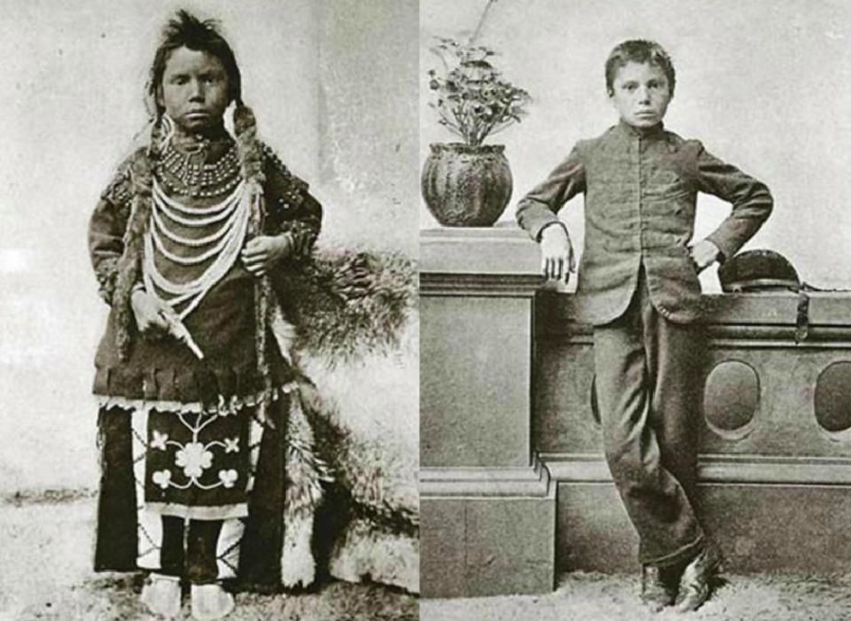
(1) What are some key differences between the left and right sides of both photos? (2) What do you think happened to the people in these two pictures?

Slide 2
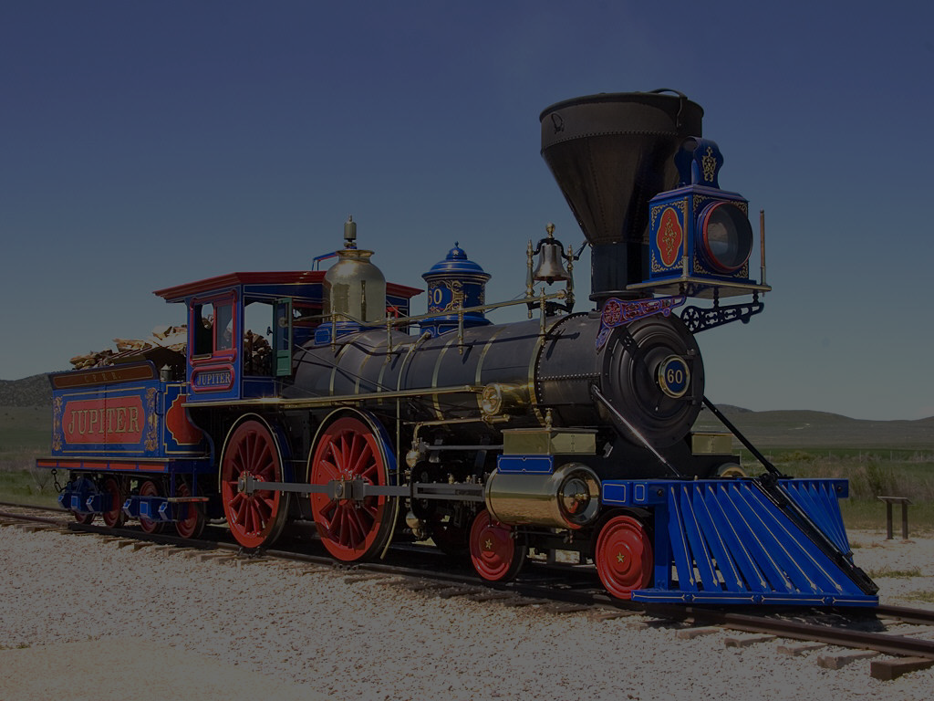
US 8.92 & 8.93
Trace the evolution of federal policies toward Native Americans, including movement to reservations; assimilation, boarding schools, wars with Indians (Little Big Horn and Wounded Knee), and the impact of the railroad and settlement patterns of pioneers, Buffalo Soldiers (George Jordan), and the Dawes Act.
Explain the significance of various American Indian leaders, including: Crazy Horse, Geronimo, Sitting Bull, and Chief Joseph.
Photo Credit: Mr Snrub

Slide 3
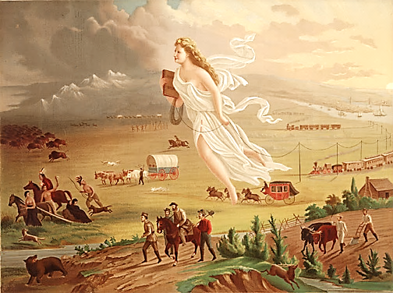
Conquest of the American West

Slide 4
MISSION ACCOMPLISHED

Slide 5
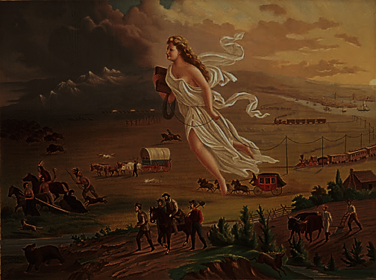
NOT QUITE

Slide 6
There’s still stuff in my way!

Slide 7
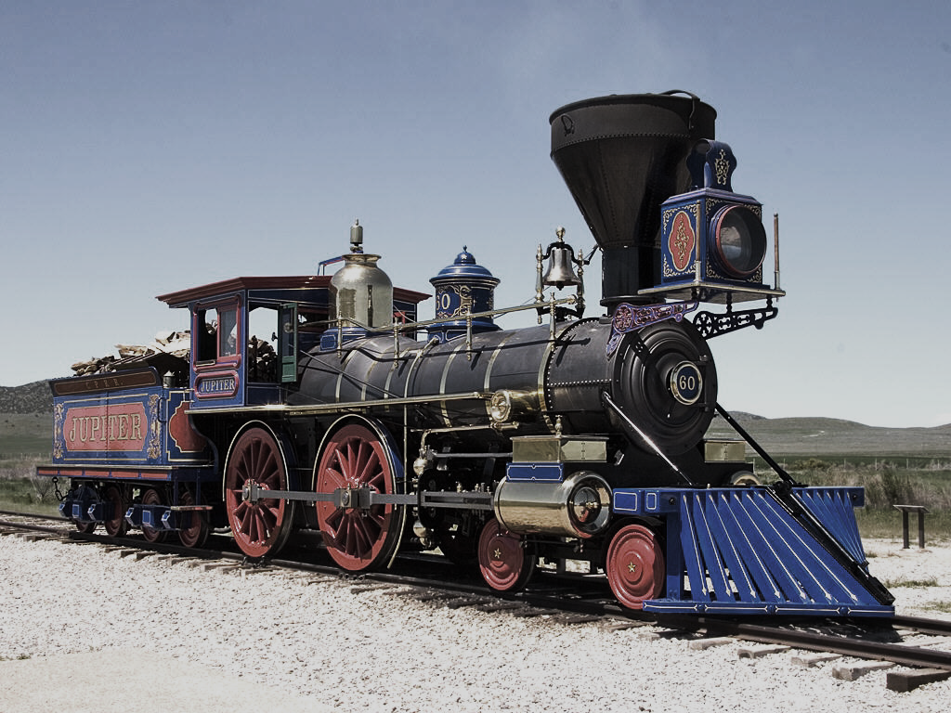
Transcontinental Railroads
Photo Credit: Mr Snrub

Slide 8
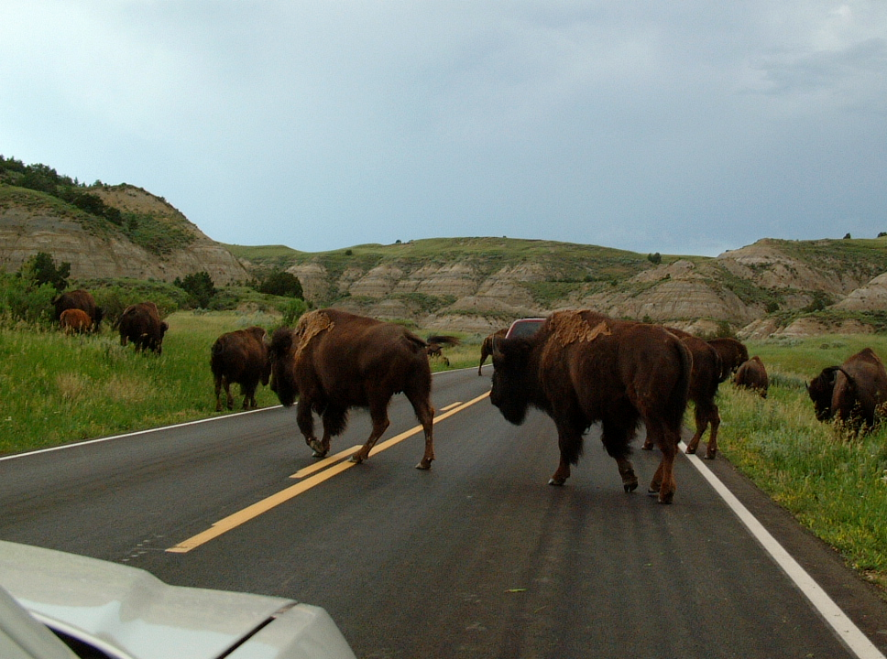
If this car were a train...
Some rights reserved by Seth W.

Slide 9
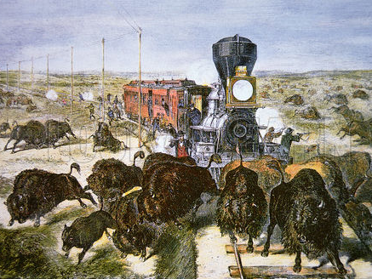
This just isn’t going to work...

Slide 10
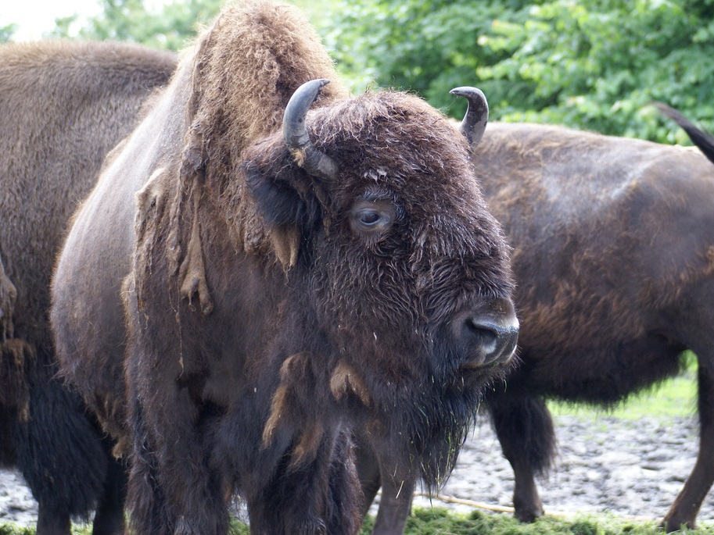
BYE, SON!
Some rights reserved by viralbus

Slide 11
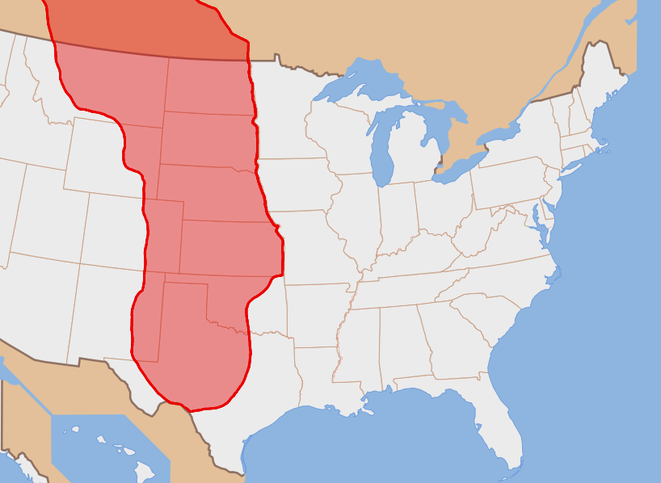
Prior to 1870, MILLIONS of buffalo roamed the Great Plains.

Slide 12
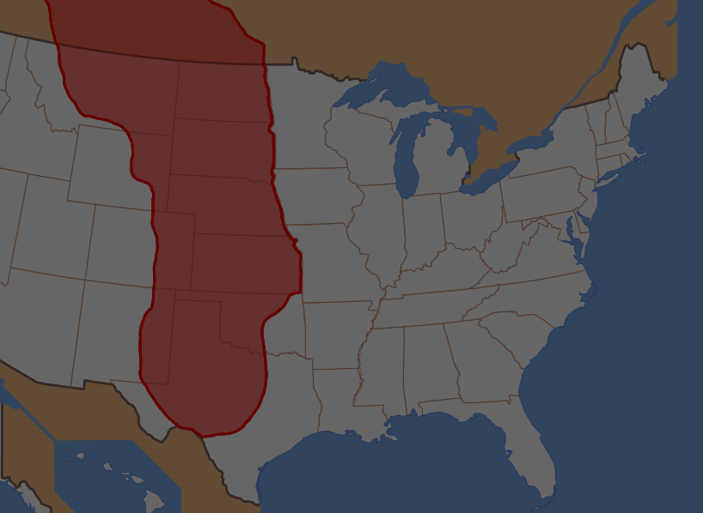
By 1900, they were nearly EXTINCT.

Slide 13
Plains Indians
The extermination of the buffalo made it impossible for the Plains Indians to continue their way of life.

Slide 14
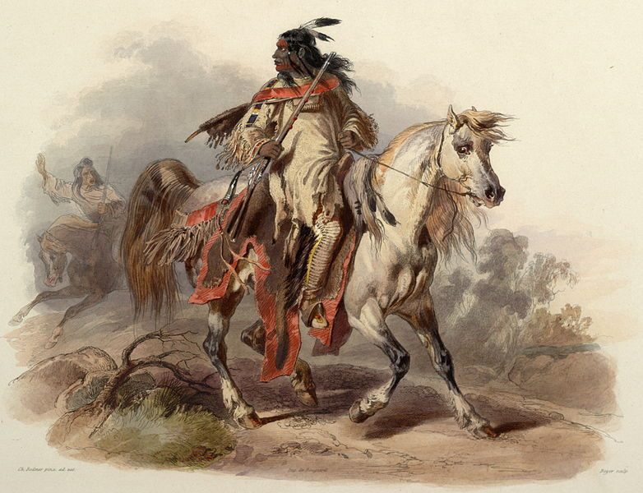
The Indians were also in the way

Slide 15
600,000 Families
Map Credit: Golbez

Slide 16
FREE LAND

Slide 17
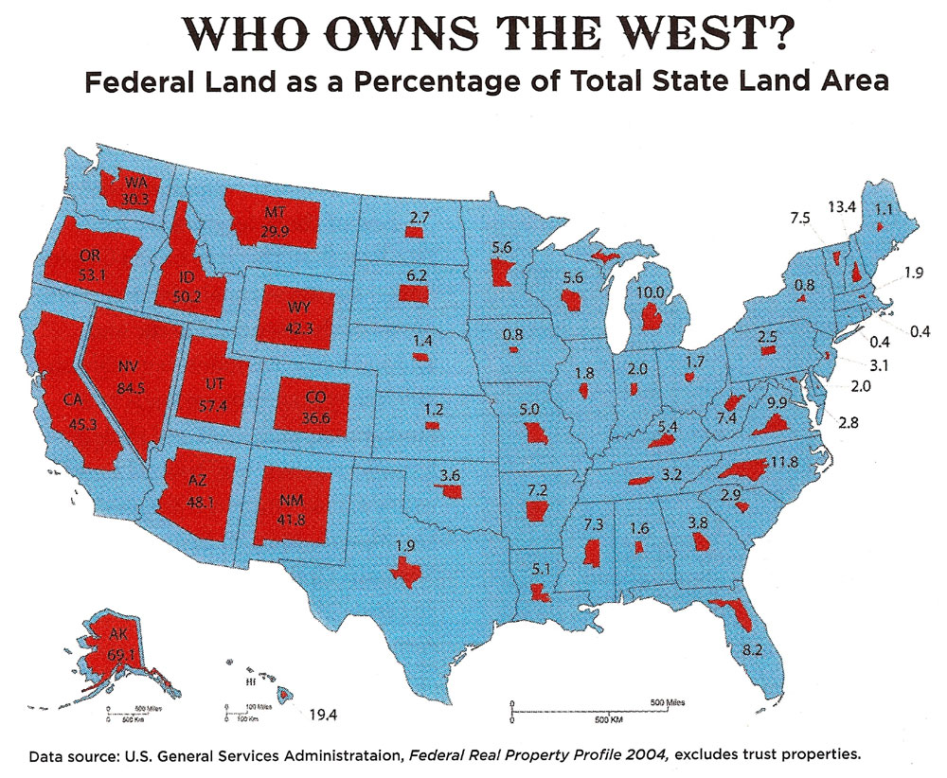

Slide 18
LOTS
of Federal Land

Slide 19
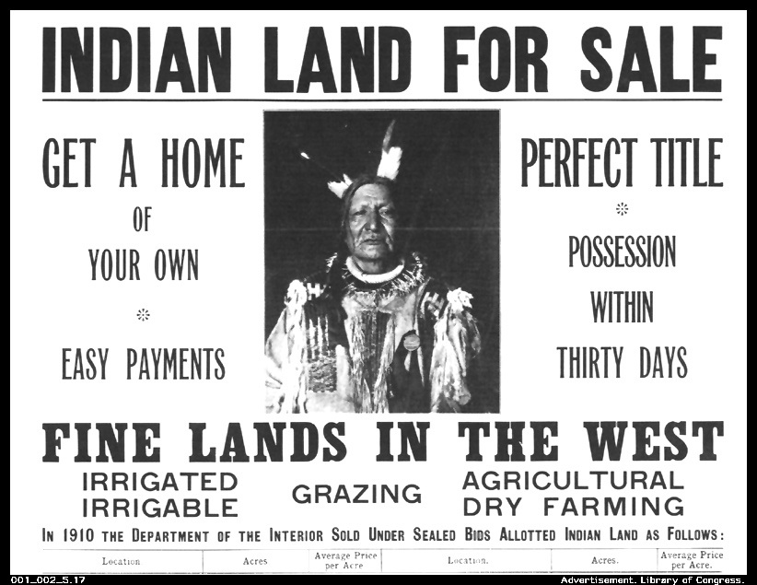

Slide 20
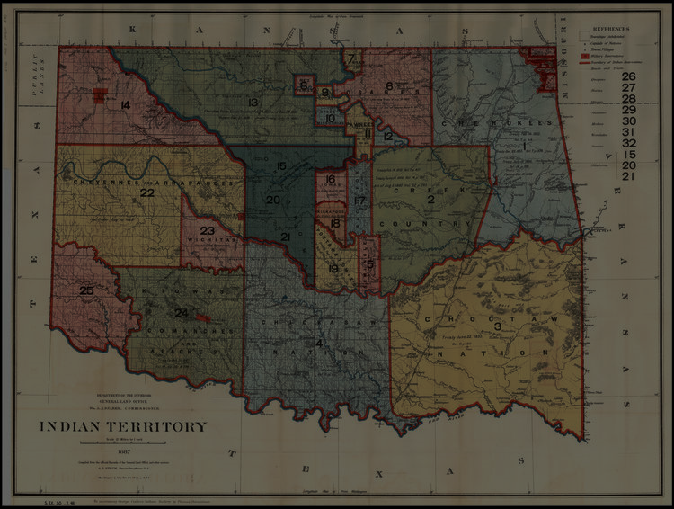
Dawes Act
(1887)
Reservations were broken up and tribal lands were distributed to individual Indian families. Why?
Assimilation
Break up tribes/communities
Make Indians Farmers

Slide 21
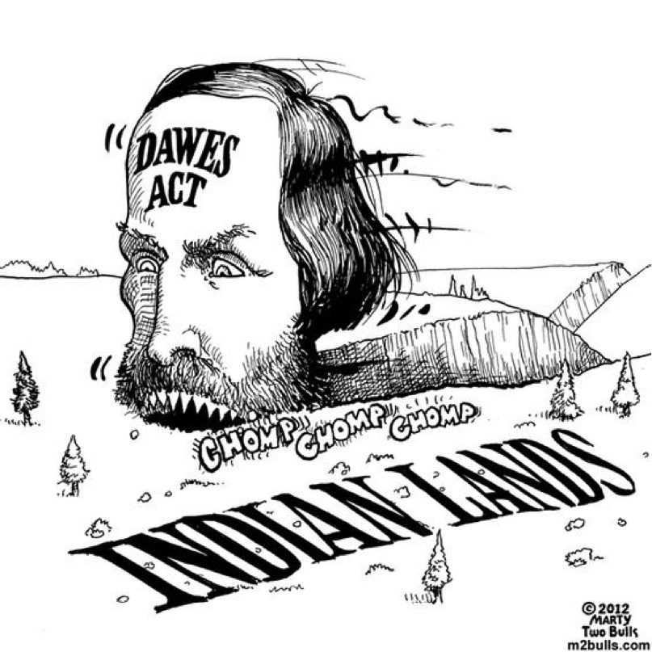
Dawes Act
(1887)
Surplus lands in Indian Territory were opened to white settlement.

Slide 22
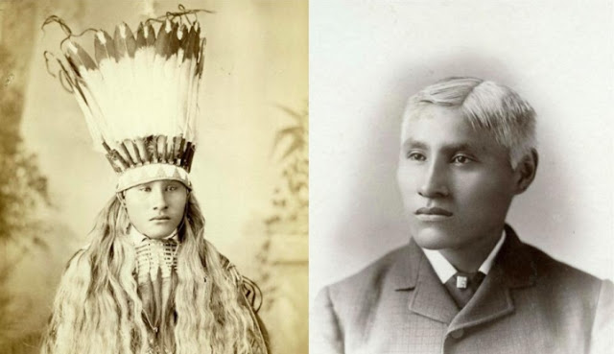
Indian Boarding Schools
“Kill the Indian, Save the Man.”

Slide 23
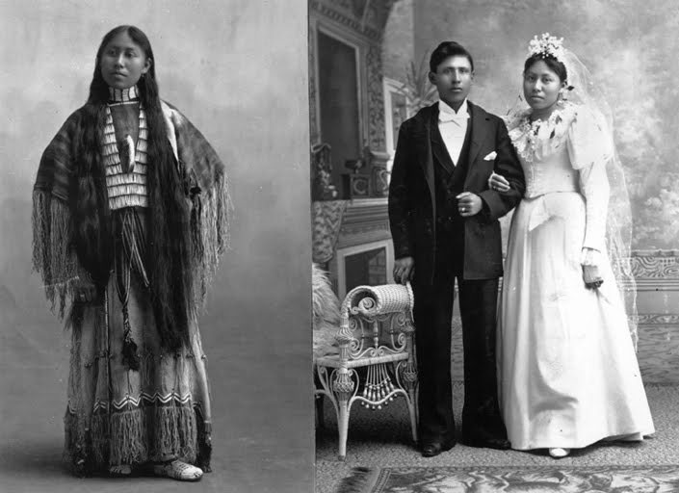
GOAL: ASSIMILATION

Slide 24
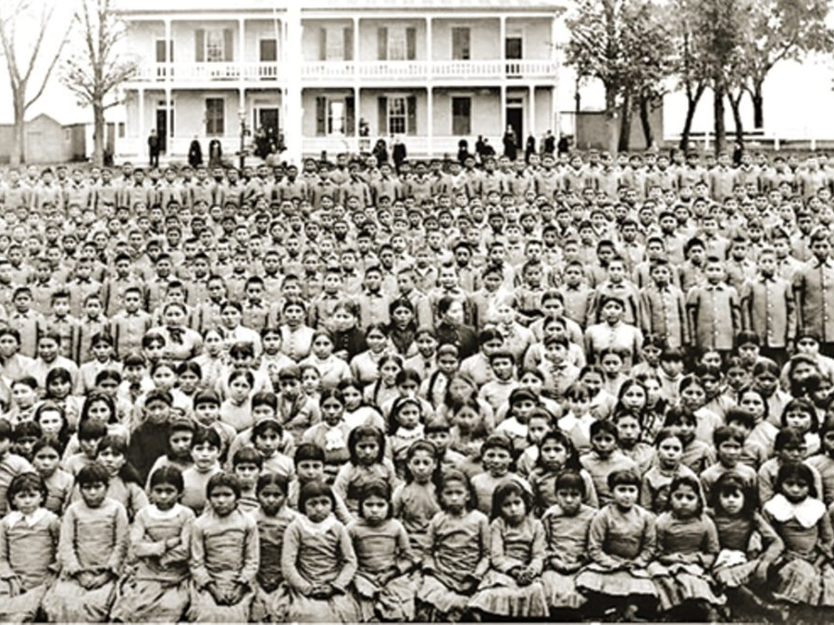
Abuse at School
Children were:
Forced to change their names
Forced to cut their hair
Beaten if they spoke their language
Got their heads smashed into walls
Were starved for days

Slide 26
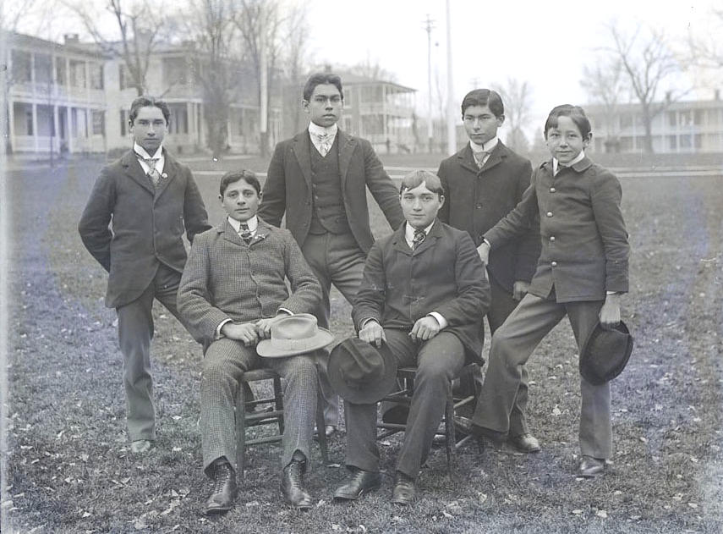
Carlisle Indian School (PA), 1879-1918

Slide 27
THE INDIAN WARS

Slide 28
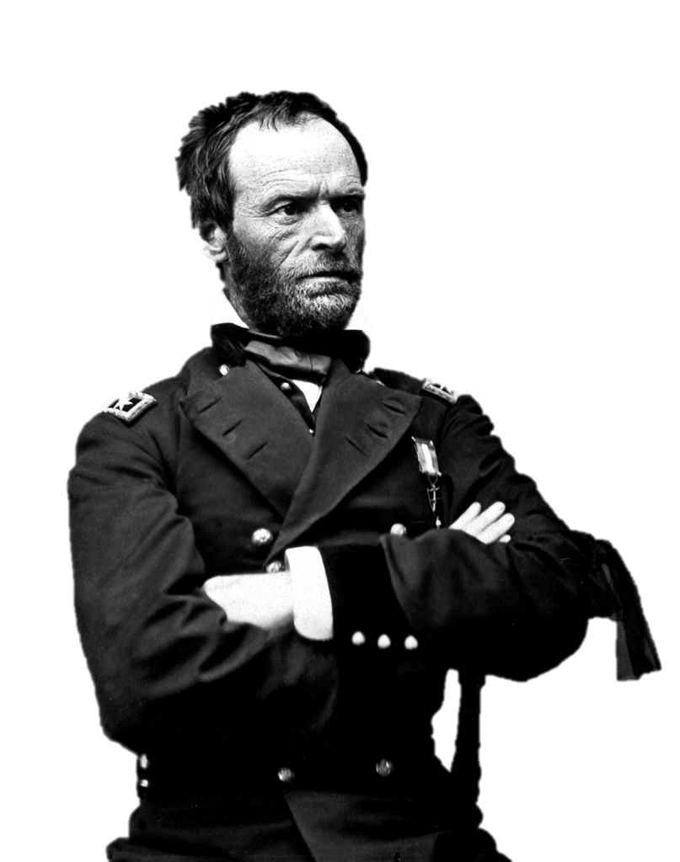
Final Solution
Gen. William T. Sherman used this phrase decades before Hitler.

Slide 29
“Hostilities between the races will continue till the Indians are all killed or taken to a Country where they can be watched.”
William T. Sherman
June 10, 1867

Slide 30
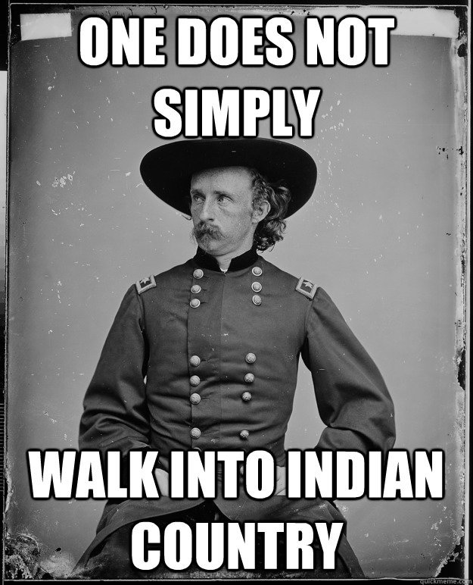
Battle of Little Bighorn
Why?
Gold found on Native lands
Supposed to move to reservations
Results?
Indians defeat U.S.
NOT Victory! Why?
Indians lose more land

Slide 31
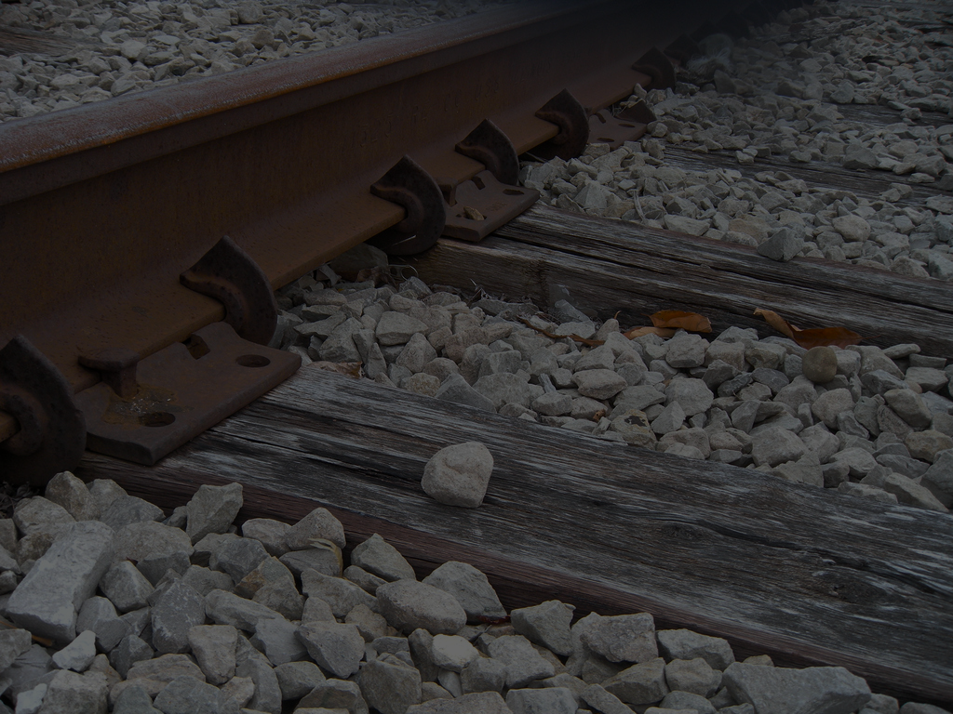
By 1890, all tribes had been placed on reservations
http://www.slate.com/culture/2018/04/the-chinese-must-go-by-beth-lew-williams-reviewed.html
Some rights reserved by SG_Design

Slide 32
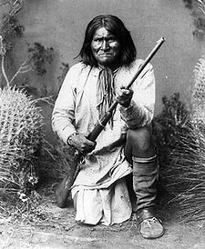
Apache Wars
1849-1886
Last Tribe to offer armed resistance to the U.S.
Geronimo

Slide 34
Wounded Knee Massacre
1890
The last armed conflict between the U.S. Army and Native Americans

Slide 35
genocide
90 men
200 women & children

Slide 36
Virtual Museum Exhibit

