Slide 1
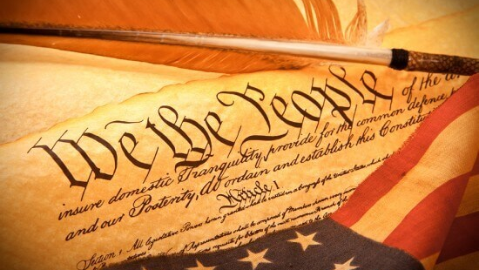
Declaring Independence Vocabulary Lesson
8th Grade Social Studies
Development of a New Nation (1720-1787)
Mrs. Wagner
Notes:
This is to reinforce the lesson on Declaring Independence by building student vocabulary about common U.S. terms they will need to know for future classes and to be good citizens.

Slide 2
Give Me Liberty or Give Me Death! Patrick Henry 1775
Liberty
Tyranny
Petition
Notes:
I chose these words because (1) they are on Marzano’s vocabulary word listing and (2) they are either abstract words that may or may not be used often (liberty, tyranny) or a concrete word (petition) that is not used as often but may be applicable to their involvement in legislative process later in life.

Slide 3
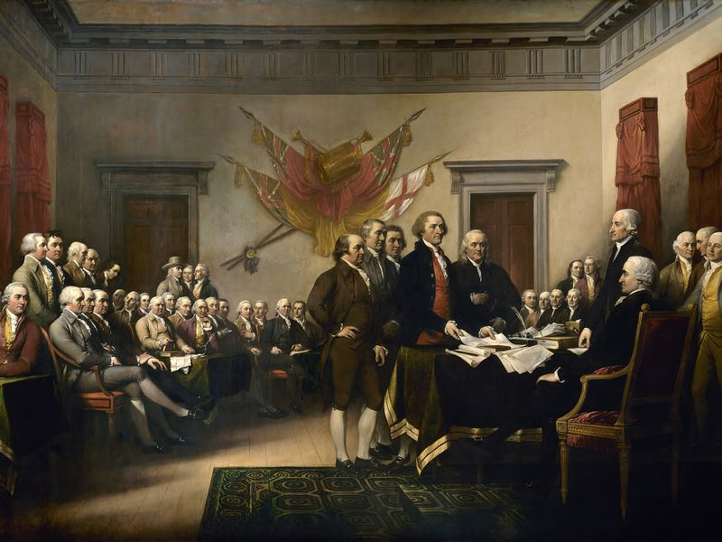
The Declaration of Independence Thomas Jefferson 1776 (Text: The Declaration of America’s Immense Offense, 2015)
Ratify
Preamble
Declaration of Independence
Notes:
I chose these words because (1) they are on Marzano’s vocabulary word listing and (2) because they are essential to the understanding of the U.S.’s founding documents. (Declaration of Independence and the Constitution)

Slide 4
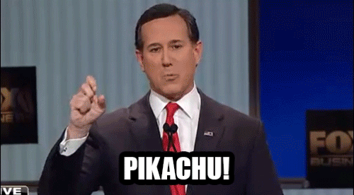
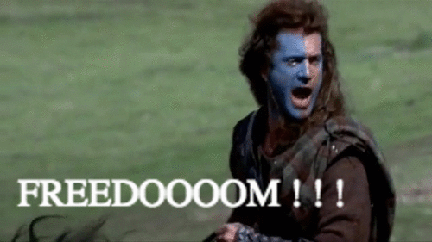
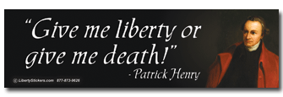
Liberty
Notes:
“Liberty” is very similar to the word freedom, and it is the power to choose or act for yourself without restrictions or control. Patrick Henry stated in his speech that he would rather die than not be able to choose his own path.

Slide 5
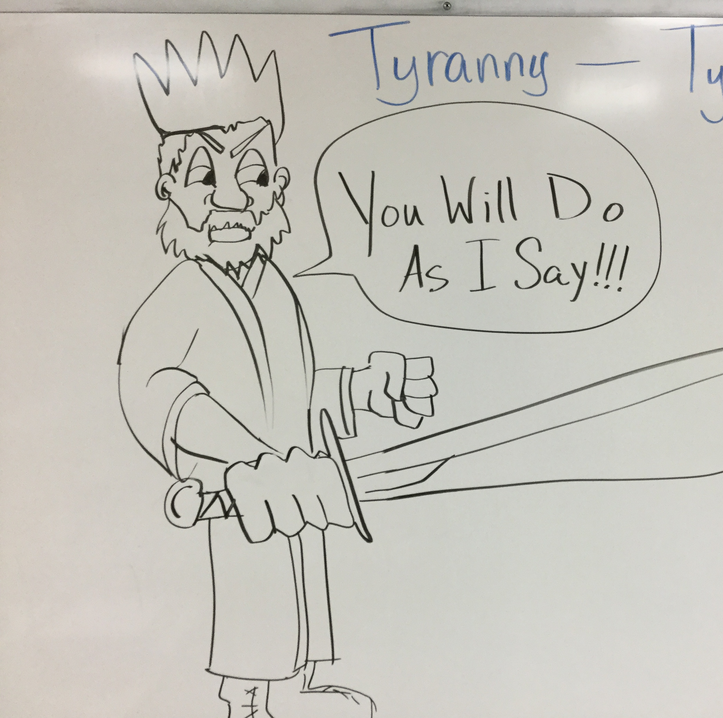
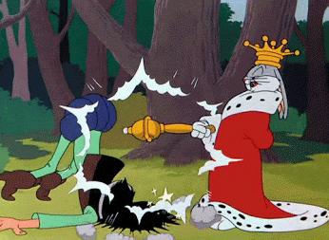
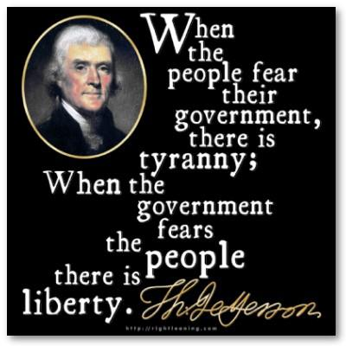
Tyranny/ Tyrannical
Notes:
Severe or harsh treatment
Oppressive government
Cruel and unfair treatment by someone in authority

Slide 6
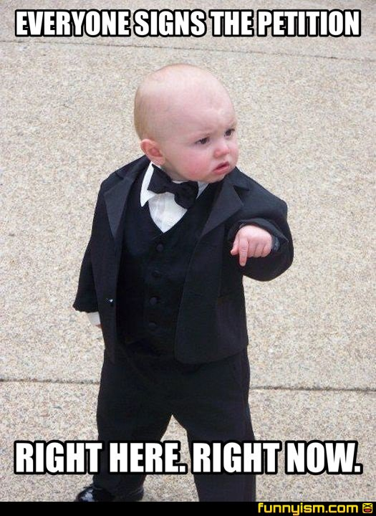
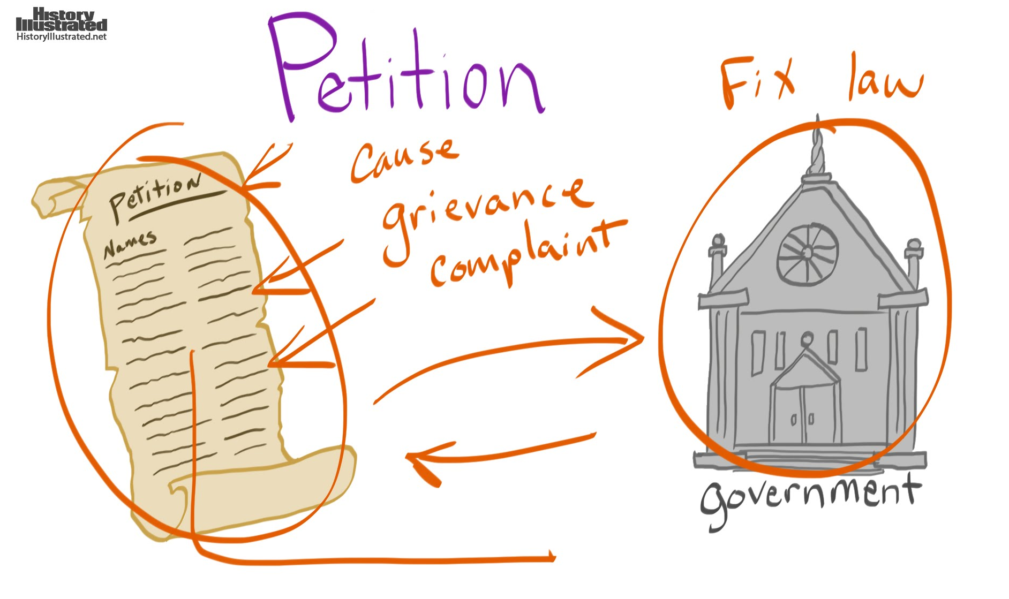
Petition
Notes:
A petition is a document that outlines a complaint and has many signatures that agree with that complaint. The petition is given to the government to fix the law. The King of England refused to even hear/see the petition given by the American colonists!

Slide 7
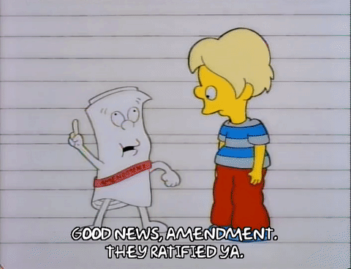
Ratify
Notes:
To ratify means to confirm, approve, or sign. The Declaration of Independence and the Constitution were “ratified” by acquiring the appropriate signatures and/or approvals. All amendments to the U.S. Constitution have to be “ratified” or approved!

Slide 8
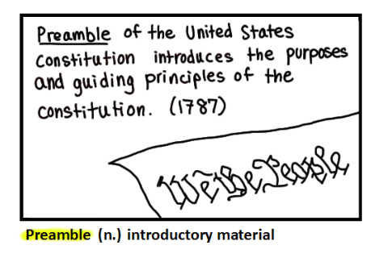
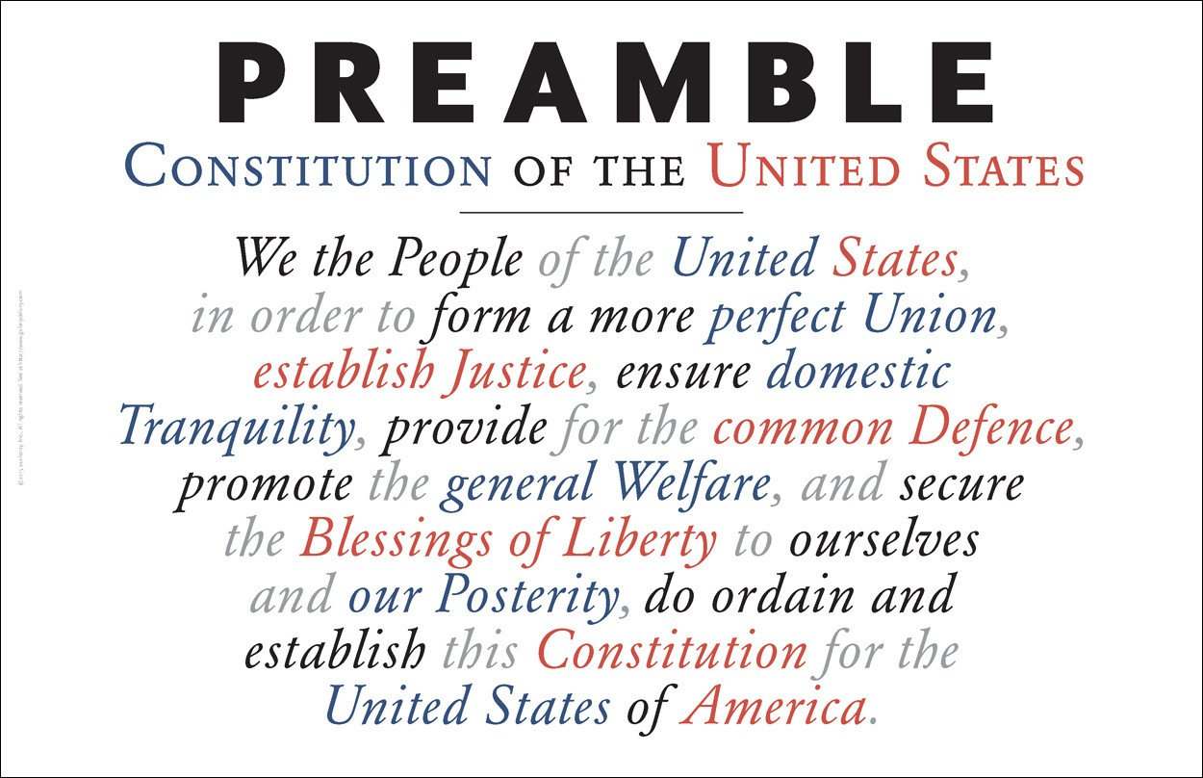
Preamble
Notes:
A preamble is simply an introduction. An introduction should explain the purpose, aims, and justification of the document. The most famous “preamble” is the introduction to the U.S. Constitution.

Slide 9
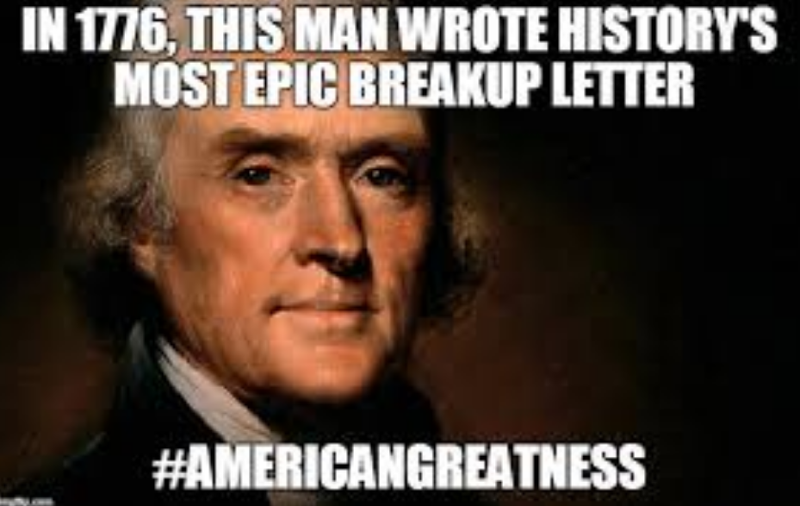
Declaration of Independence
Notes:
The Declaration of Independence was the official “break-up” letter to Great Britain. It declared the ways in which the U.S. sought to address their grievances, which were all ignored or punished by the king of Great Britain. This declared that the U.S. was no longer a British colony.

Slide 10
Now, it is your turn! http://www.quickmeme.com/caption In groups, create a meme for each vocabulary word. Please explain your choice of memes and text.
Declaration of Independence Example:
Notes:
This activity addresses Marzano’s steps two and three. The meme allows the student to graphically and textually express what they believe each word means. It also forces them to evaluate what they know about the word and apply it to something ironic and even funny. I will monitor students as they complete this activity.

Slide 11
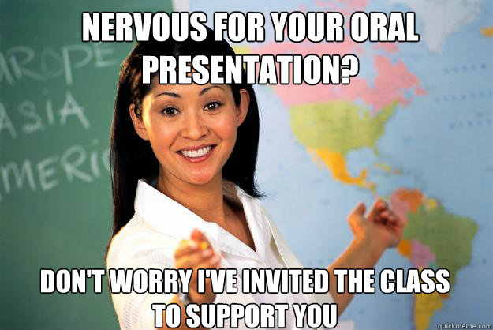
Share your memes!
Notes:
This addresses Marzano’s step five. The groups of students will each take turns presenting their memes to the class, justify their work, and helps other students obtain a deeper understanding of each vocabulary word.

Slide 12
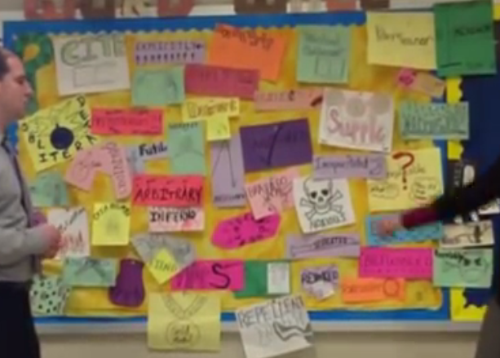
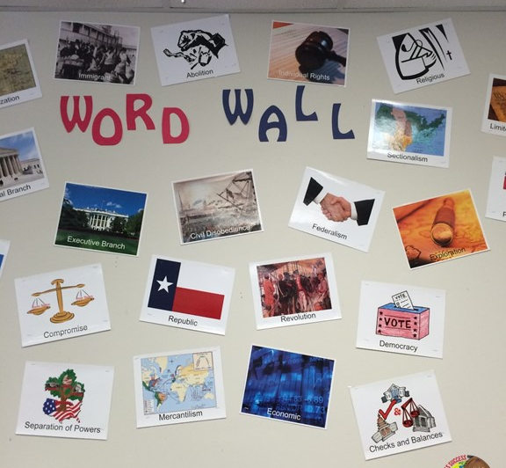
Share your memes on the word wall!
Notes:
I will have a “word wall” full of graphic representations of historical vocabulary, concepts, events, and more. I will name it the “Berlin Wall.”

Slide 13
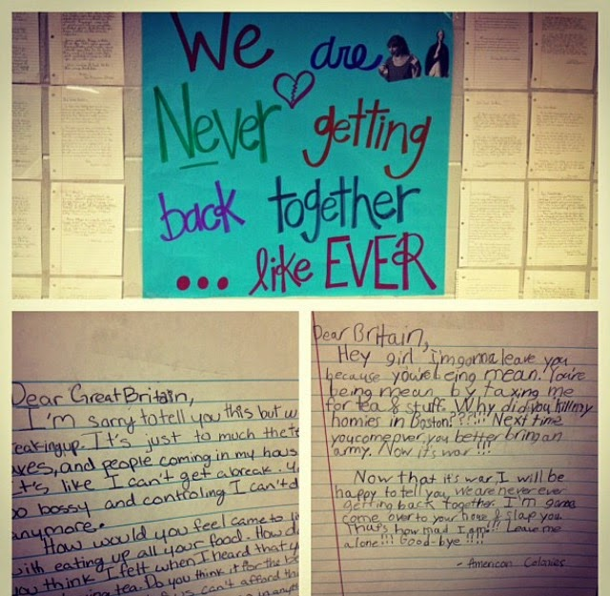
BREAK UP LETTERS Write a “break up” letter to Great Britain using all of the vocabulary terms! (Remember, your break up letter is your Declaration of Independence!
Liberty
Tyranny
Petition
Ratify
Preamble
Notes:
This addresses Marzano’s step four, as it exposes the students to an activity to deepen their understanding. They must use each word within their “break-up” letter to Great Britain (or their Declaration of Independence.) This also again addresses Marzano’s step five as they share their letters with others in the class.

Slide 14
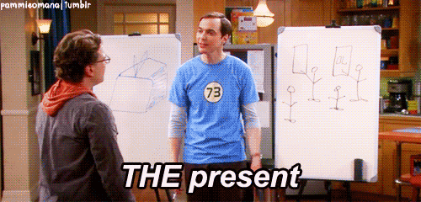
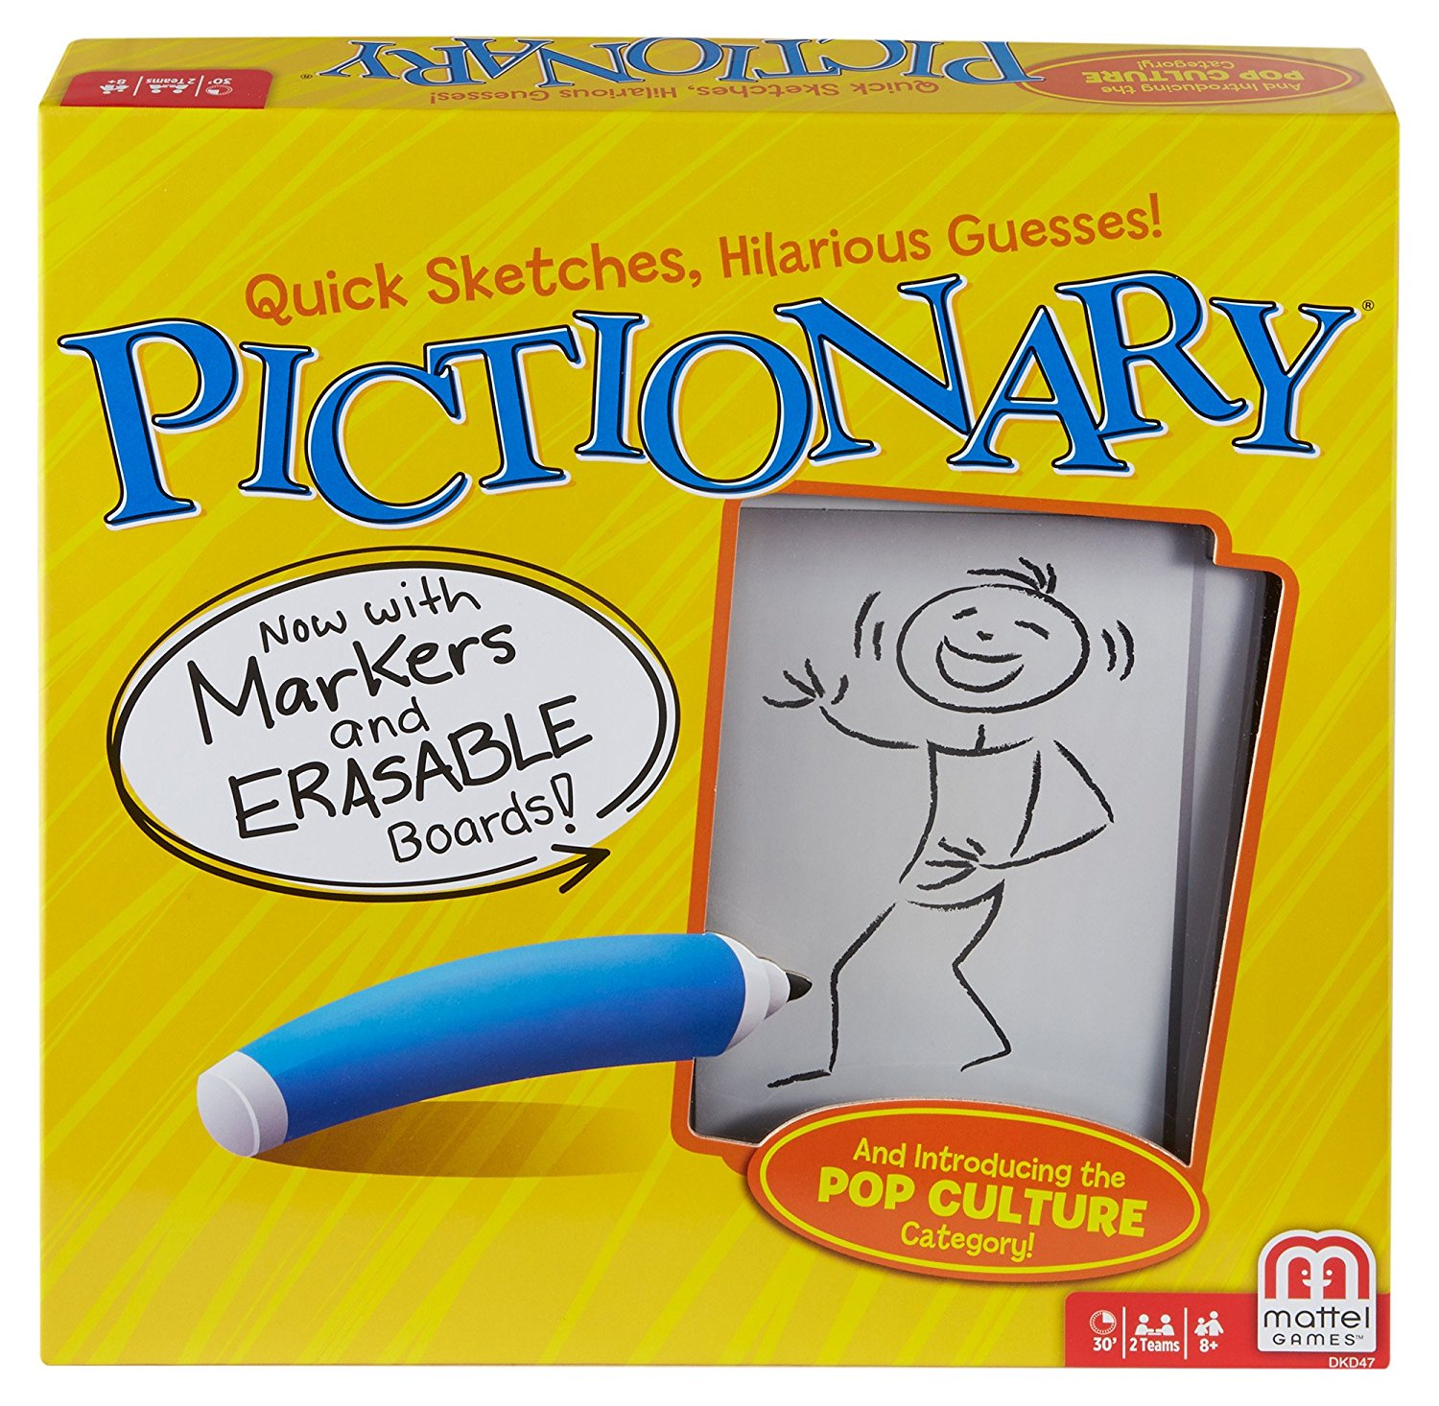
Charades/Pictionary! Act it out or draw it!
Notes:
This addresses Marzano’s step six, which reinforces each term by playing games and involving them in activities. I will model another word (like frog and jump) for Pictionary and Charades. Then the student will choose a card. There will be two cards for each vocabulary word – one requiring the student to act it out, another requiring the student to slowly draw the image. The class has to guess

Slide 15
“We are never, ever getting back together!” – America to Great Britain
Notes:
This is a transitional video to end on a “light note.” The class has discussed the reasons for the American Declaration of Independence, now they will begin to learn about the actual war effort.

