Slide 1
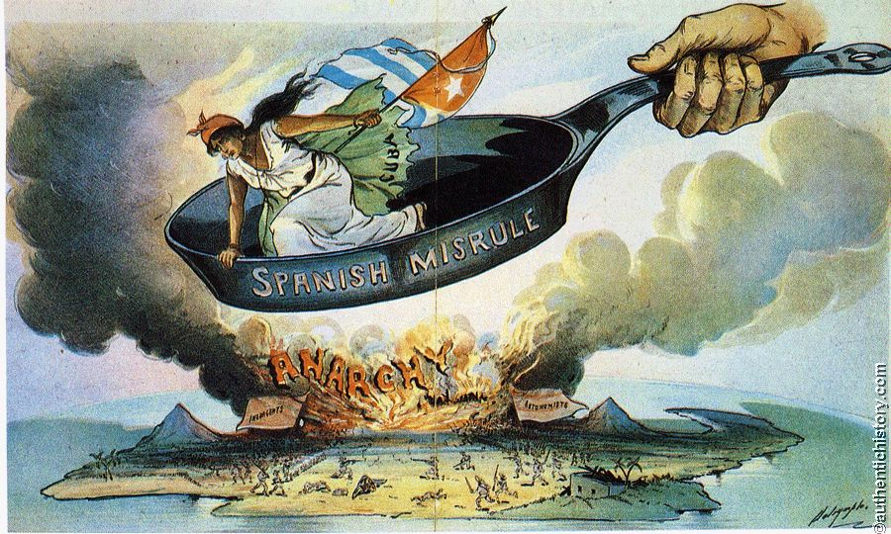
WARM UP
Would you stand up to protect someone who was being bullied?
If you did, what might be some of the potential consequences?
Notes:
Who is in the frying pan?
What does the frying pan represent?
What does Anarchy mean?
What is on fire? What looks like hell on earth?

Slide 2
CONTENT STANDARDS
US 22 – Assess the causes of American imperialism in the late 19th and early 20th centuries, including the desire for raw materials and new markets, yellow journalism, and the desire to spread American democratic and moral ideals.
US 23 – Evaluate the arguments of interventionists and non-interventionists of the period including Alfred T. Mahan, Senator Albert Beverage, Mark Twain, and Theodore Roosevelt.
US 24 – Describe the consequences of American imperialism of the period, including the following events: Spanish-American War (Teller, Platt & Foraker Acts)

Slide 3
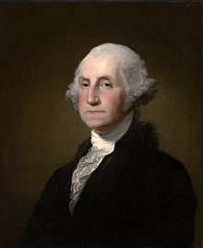
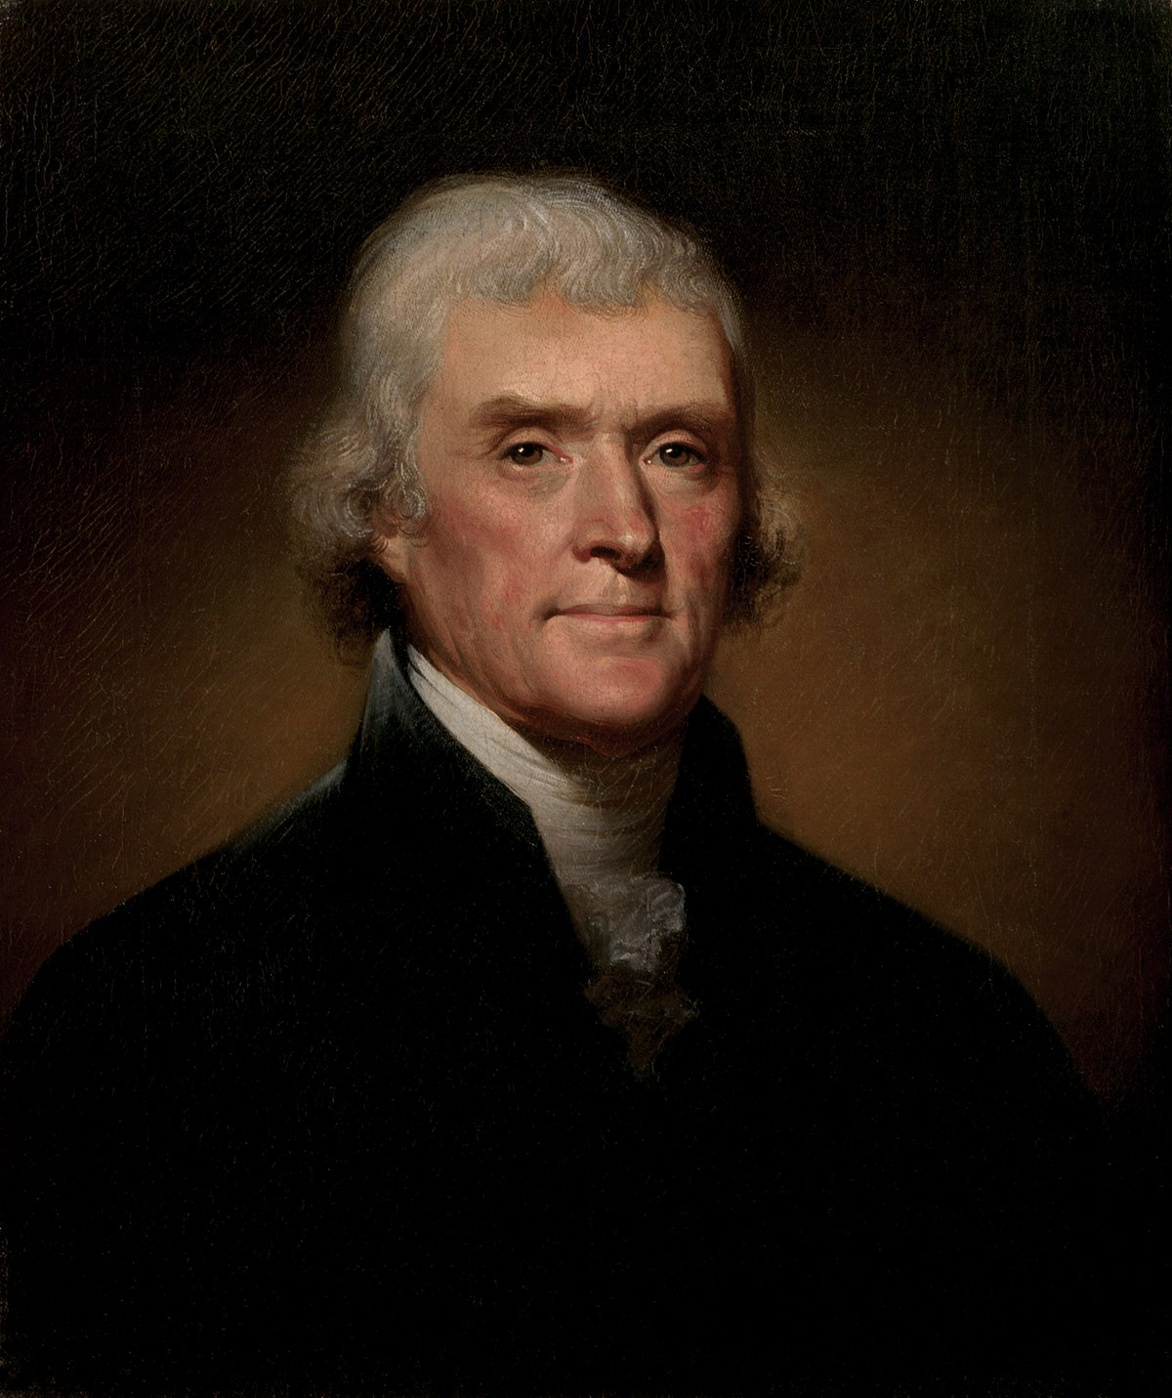
“ISOLATIONISM”

Slide 4
Washington’s Farewell Address
“It is our true policy to steer clear of permanent alliances with any portion of the foreign world…”

Slide 5
Jefferson’s Inaugural Address
“Peace, commerce, and honest friendship with all nations, entangling alliances with none…”

Slide 6
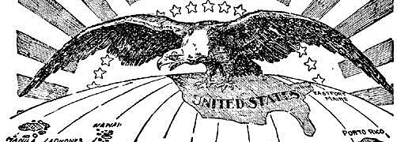
How did the United States go from an isolated nation to being a world power?

Slide 7
HELLO,
CUBA!!

Slide 8
BIG YEAR
1898

Slide 9
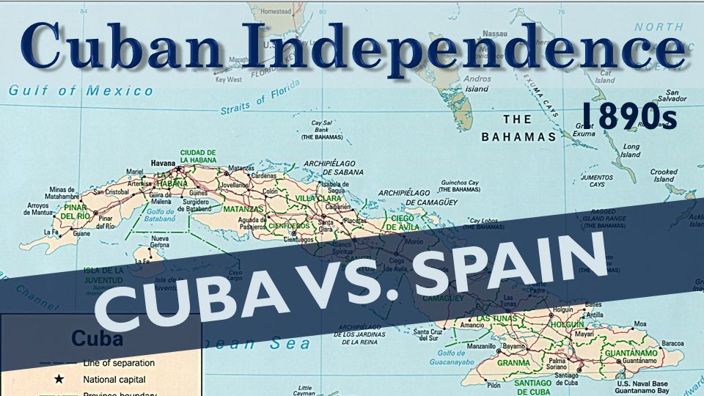

Slide 10
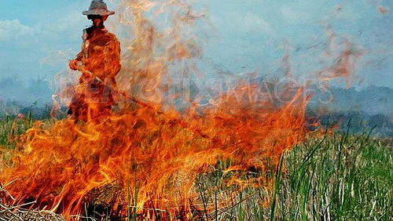
Cuban insurrectos (revolutionaries): “Ha, we’ll show you!” NO MORE SUGAR FOR TRADE!

Slide 11
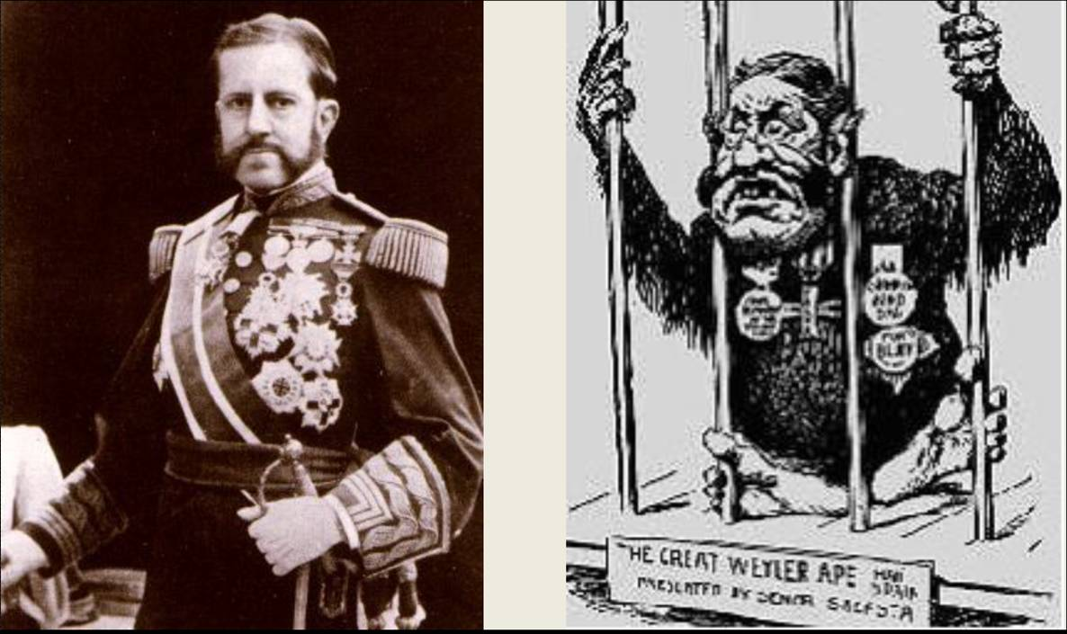
Spain sent Gen. “Butcher” Weyler!!!

Slide 12
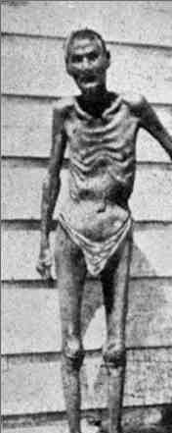
BUTCHERED CUBANS!
Concentration Camps!

Slide 13
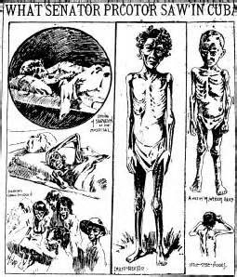
America Takes a Stand!
American press sends reporters to investigate
Sensationalized in
“Yellow Journalism”
Does America have a moral obligation to intervene? Why?

Slide 14
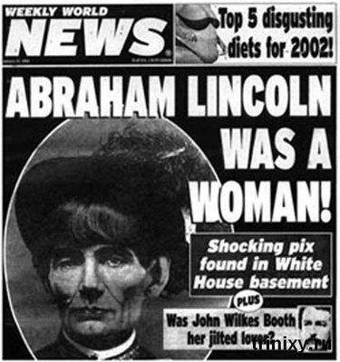
Yellow Journalism!
“Click-bait” Headlines
Exaggerated
Possibly False
Like “fake news”
Why do you think this was done?

Slide 15
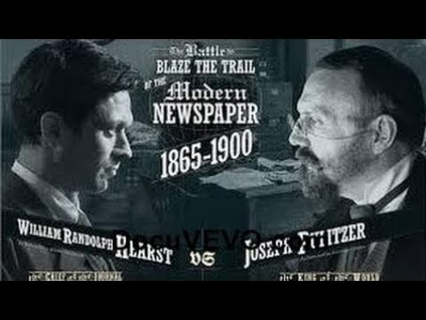
Why “yellow journalism”? Because it sells papers!
“You furnish the pictures, and I’ll furnish the war.” - Hearst
Pulitzer’s New York World
1883 | 1886
10,000 readers | 250,000 Readers
Hearst’s New York Journal
1895
400,000 Readers
Invented the comic strip!

Slide 17
Uncle Sam, Why Are You Waiting? (1898)

Slide 18
NEW President McKinley (1897)
Woah! Don’t attack! We’ll be good!
Spain has acted “uncivilized and inhuman” toward Cubans!
Recalled “Butcher” Weyler
Modified concentration policy
Granted Cuba qualified autonomy

Slide 19
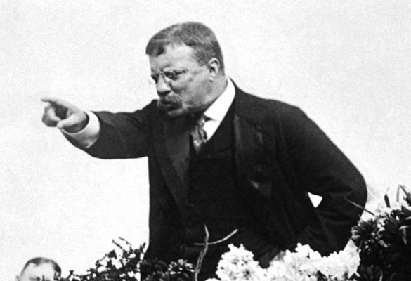
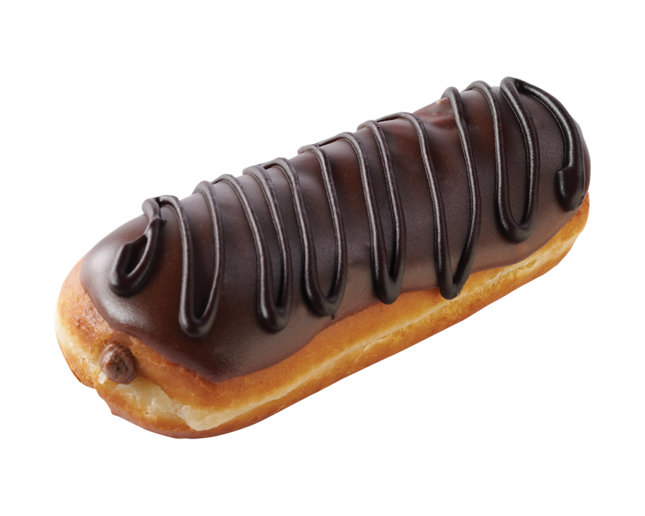
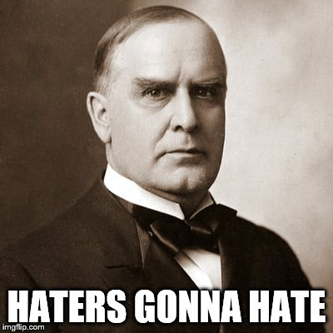
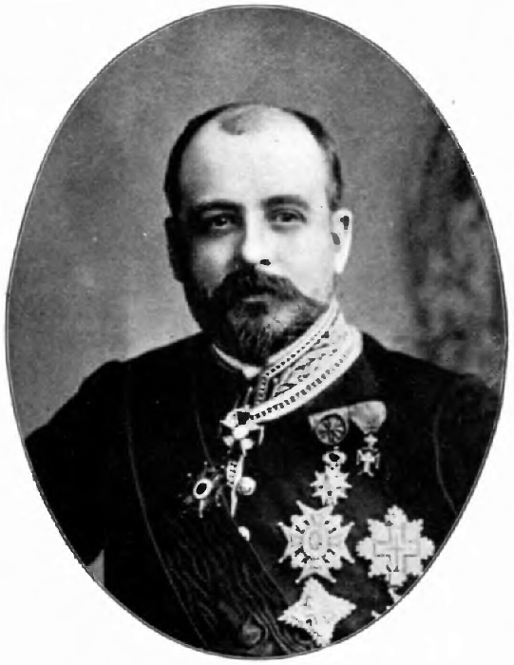
The De Lomé Letter
McKinley “has no more backbone than a chocolate éclair!”
McKinley is a weak man and “a bidder for the admiration of the crowd!”

Slide 20
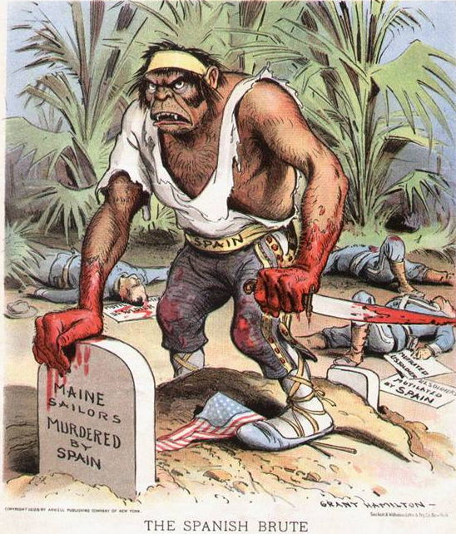
To hell with Spain, REMEMBER THE MAINE!

Slide 23
A “Splendid Little War”
Lasted 4 months
Less than 3,000 American lives lost
Treaty of Paris - America gets these colonies:
Philippines
Puerto Rico
Guam
Partial control over Cuba

Slide 24
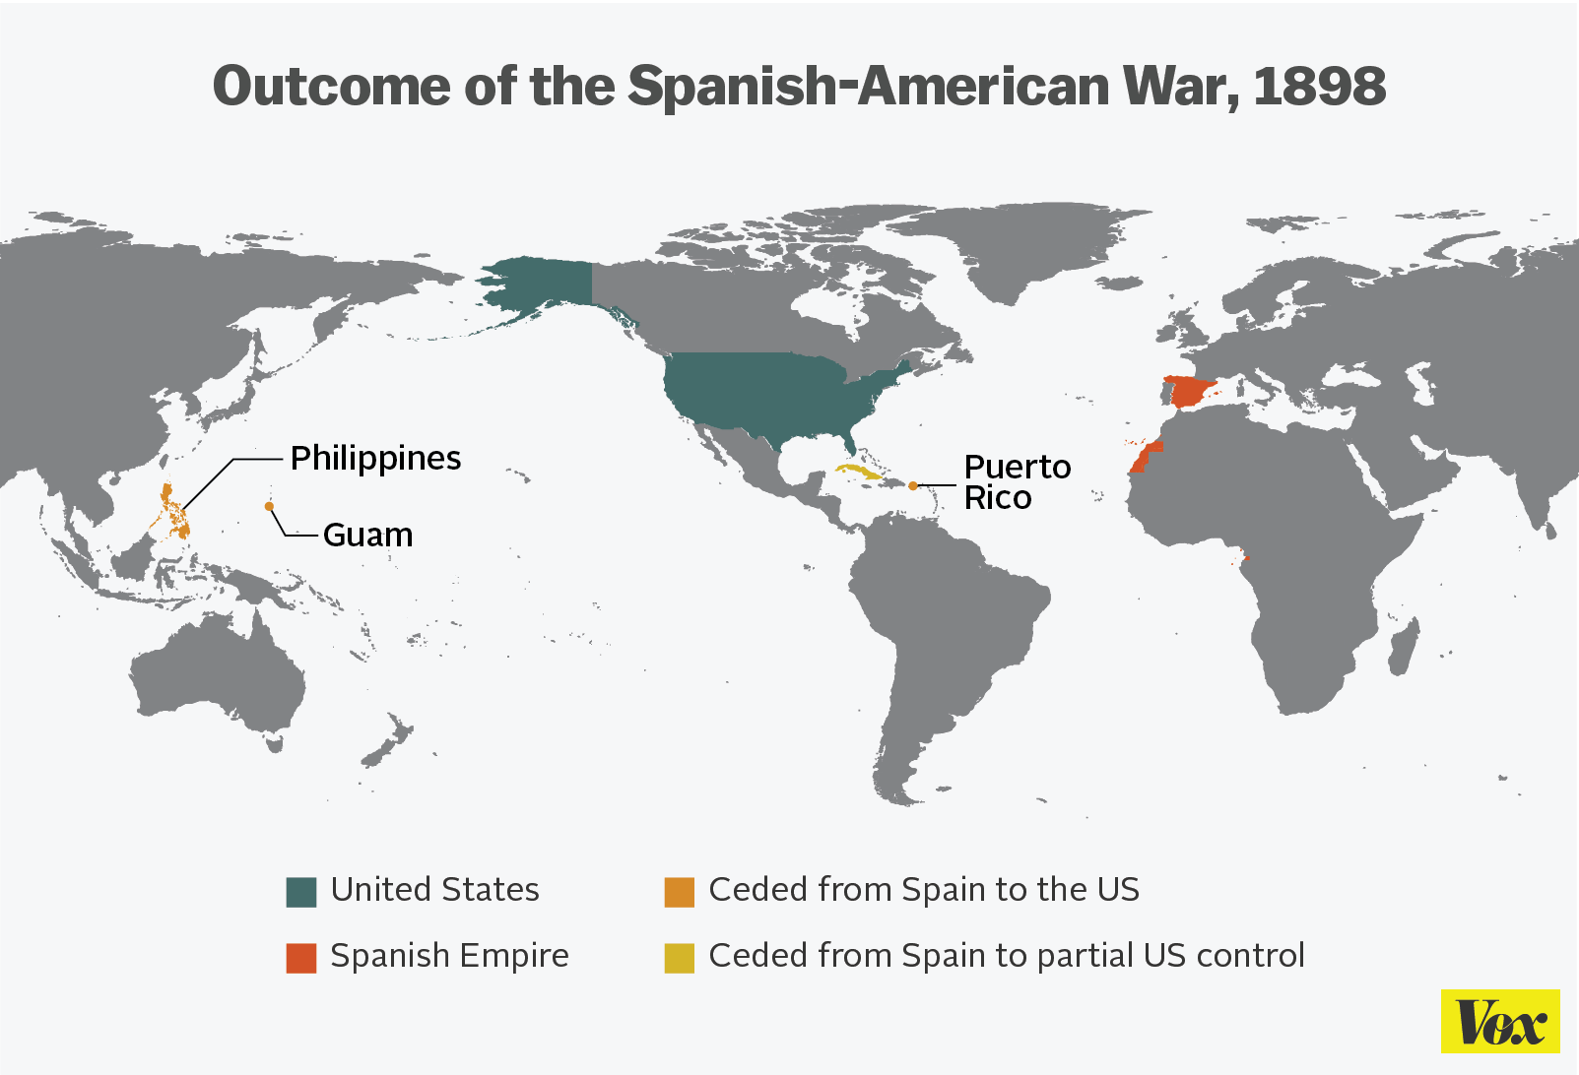
E
M
P
I
R
E

Slide 25
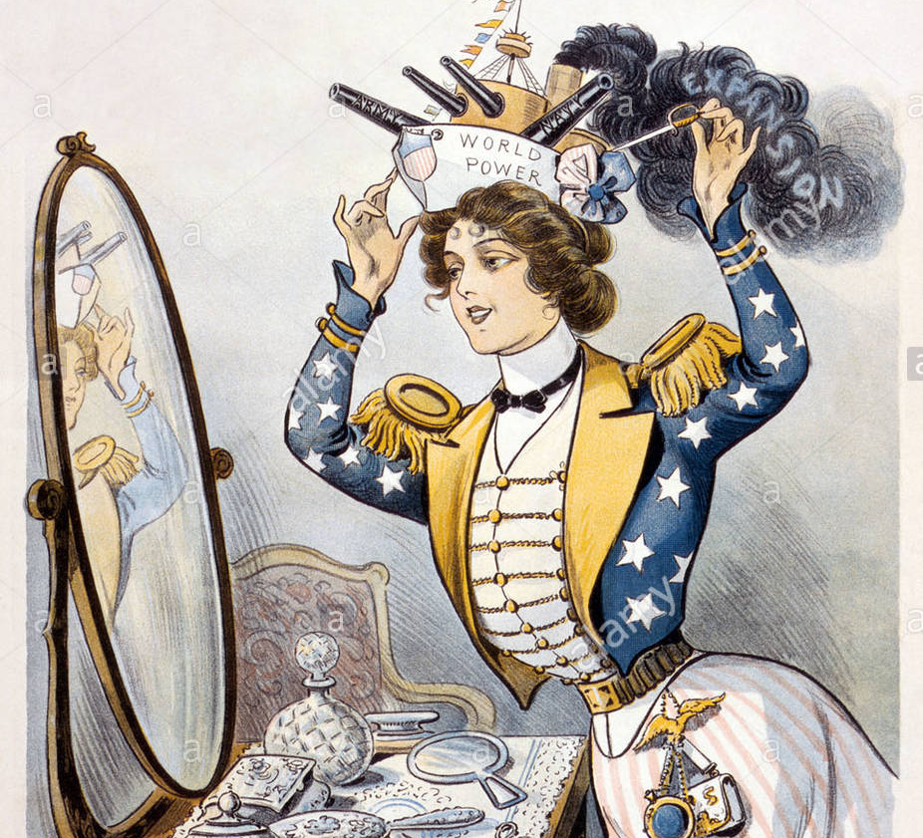
America becomes a WORLD POWER
What are the consequences
(good & bad)
about what America
has just done?

Slide 26
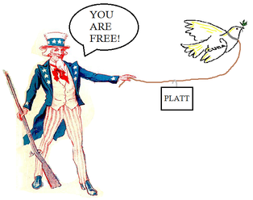
Cuban “Independence”
“That’s right, my boy! Go ahead! But remember, I’ll always keep a father’s eye on you!”
Platt Amendment
Could NOT make treaties
Could NOT be in debt
U.S. sent troops to “restore order” and provide “mutual protection”
Cuba would sell/lease land for U.S. Coal & Navy Stations
Ever heard of Guantanamo Bay?

Slide 27
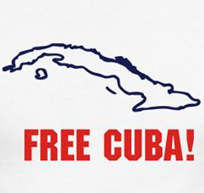
CUBA – “What about the Teller Amendment?”
Teller Amendment (1898)
U.S. promised not to annex Cuba
The U.S. would leave the island to its people
U.S. would withdraw all troops from the country after helping Cuba gain independence

Slide 29
What about Puerto Rico?
Foraker Amendment!
U.S. set up military government when Puerto Rico became a territory in 1898
Foraker Act ended military rule in 1900 and set up a civil (civilian ruled) government

Slide 31
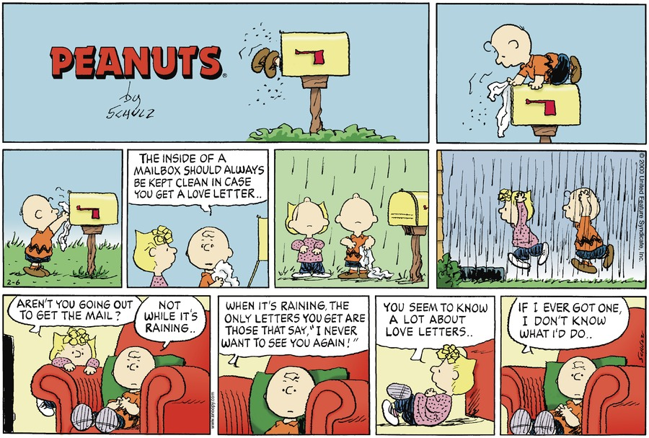
Spanish-American War Comic Strips
In pairs, create a 6 slide comic strip of the Spanish-American War:
Include a “Yellow Journalism” (Click-bait) headline for each slide
Write a short summary that details what your drawing/visual is about
Comic strip needs to be completely colored
Can be on paper, PowerPoint, etc. This is up to you!
Cuban Uprising
Concentration Camps
Yellow Journalism
U.S.S. Maine Explodes
America Goes to War with Spain
Treaty of Paris / Colonies Acquired by U.S.

Slide 33
Spanish-American War = Shift to PRO imperialism!!

Slide 36
ISOLATIONISM vs. INTERVENTIONISM
19TH CENTURY (1800s) | 20TH CENTURY (1900s)
NEUTRALITY (“Isolationism”) | INTERVENTION
AVOID conflicts with other nations whenever possible | ENGAGE other nations in order to promote the national interest of the United States

