Slide 1
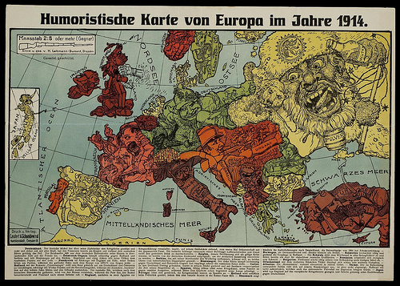
Bell Ringer
Pick up a map of Europe 1914 edition and begin labeling

Slide 2
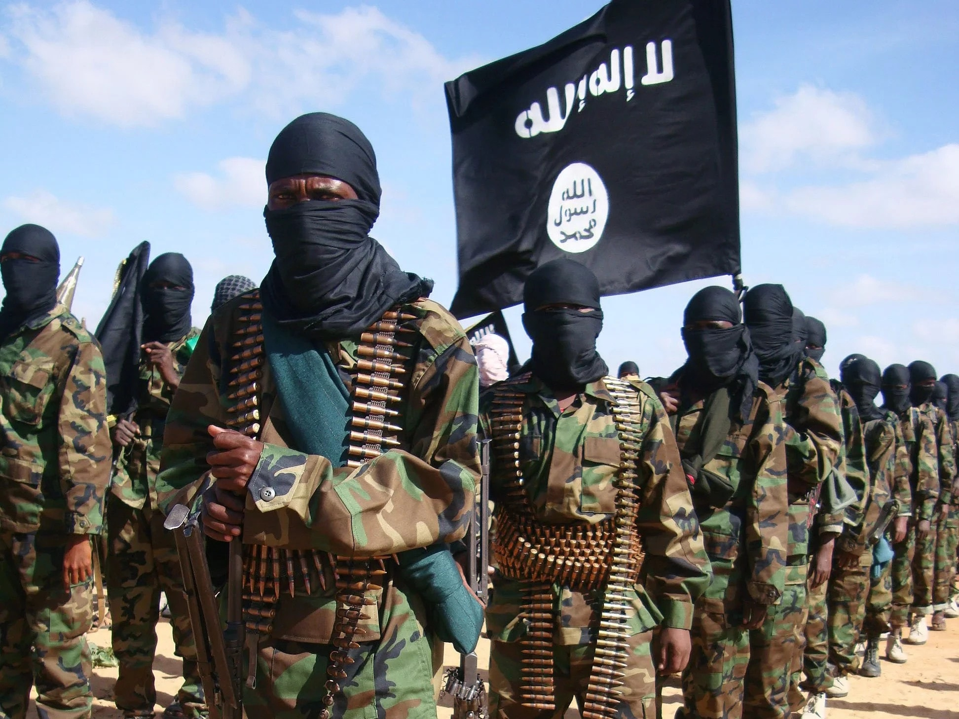
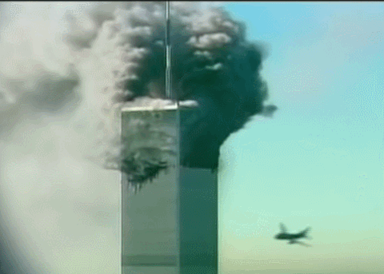
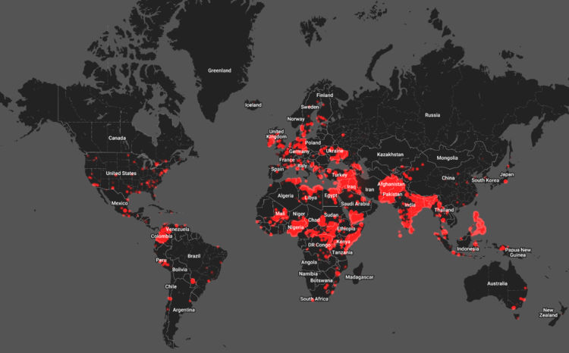
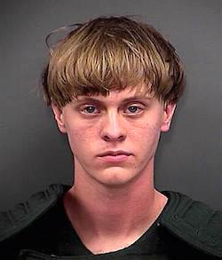
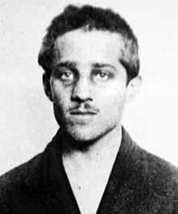
Warm Up
In your own words, what is a terrorist?
Can you name any terrorist organizations?
Do you believe one man’s actions can start a war?
2016 Map of Terrorism – Igarape Institute

Slide 3
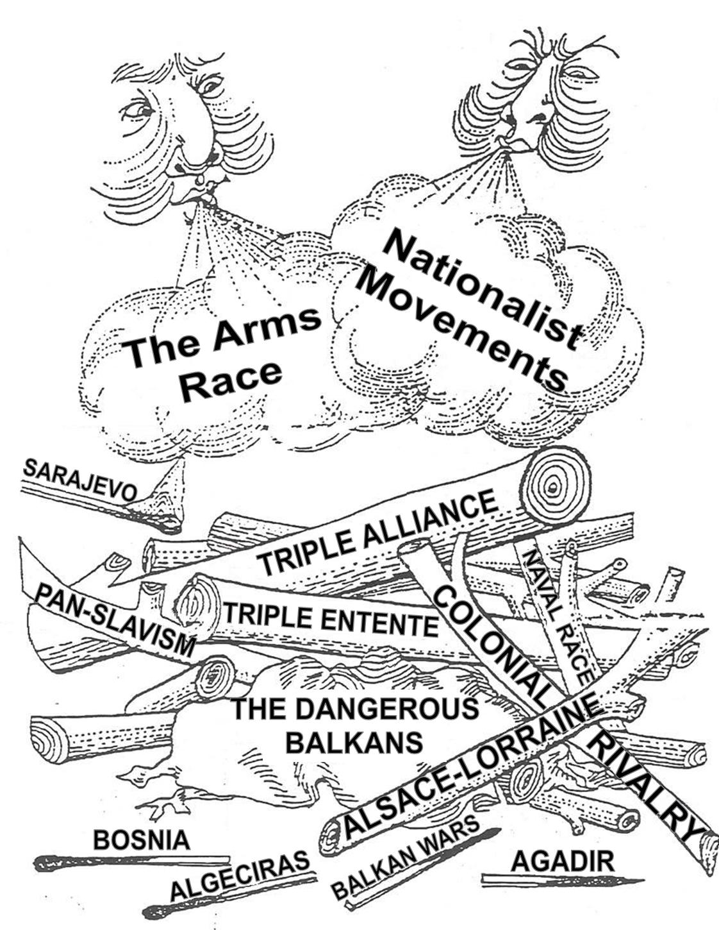
World History Standard
W.28 – Explain how the rise of militarism, alliances, imperialistic rivalries, and growing nationalism led to the outbreak of World War I.
What is the “match” that ignites the wood pile?

Slide 4
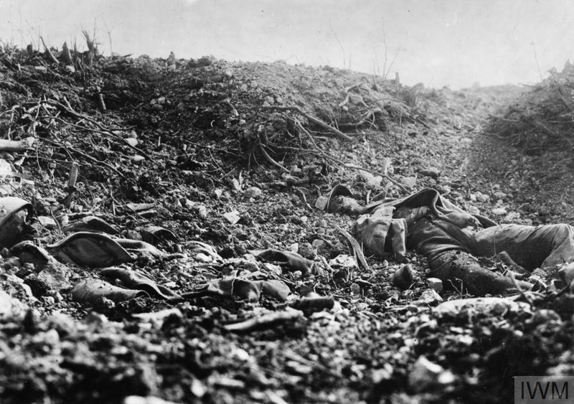
More than 65 million men from 30 countries fought in WWI. Nearly 10 million died
Casualties of 12 years of fighting in Afghanistan is equivalent to the first 20 minutes of the Battle of the Somme
Dogs and pigeons were used as messengers
Average life expectancy in the trenches was about 6 weeks
Initially the only protection against gas attacks was a cloth soaked with urine

Slide 5
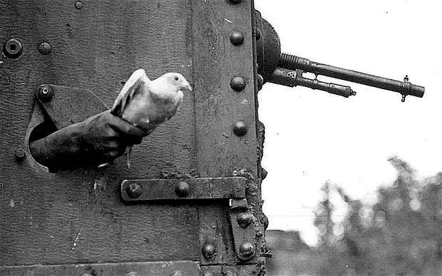
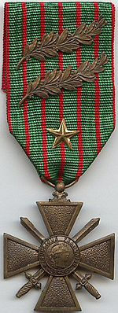
Notes:
German unmanned camera pigeon
Probably aerial reconnaissance in World War I
Cher Ami awarded French Metal of Valor in Battle for delivering 12 important messages during Battle of Verdun
Final Mission – Oct. 1918
Carrying Message in Capsule Hanging from Ligament of Her Shattered Leg
Saved 194 U.S. Soldiers

Slide 6
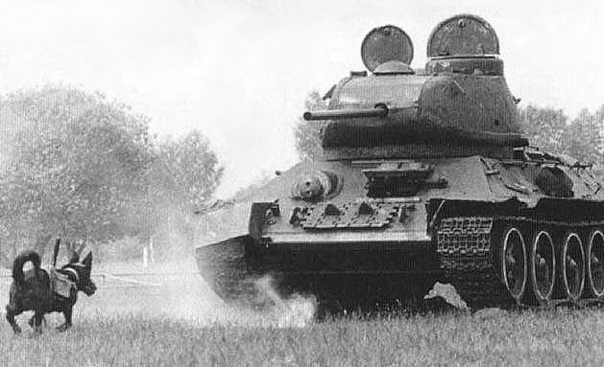
Anti-tank dogs
Carried explosives to tanks, armored vehicles and other military targets

Slide 7
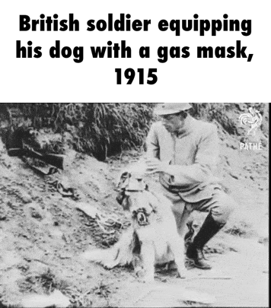

Slide 8
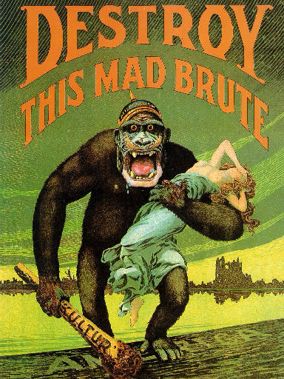
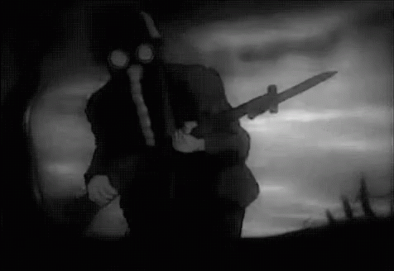
Causes of World War One
Remember M.A.I.N. + A
Militarism
Alliances
Imperialism
Nationalism
Assassination

Slide 9
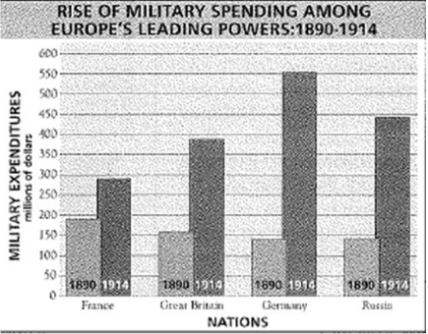
#1 Militarism
Do you see any problems here?
Who is spending the most?
Who has the most growth?

Slide 10
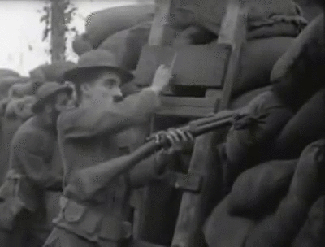
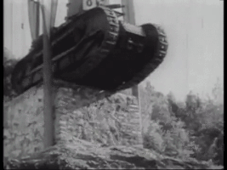
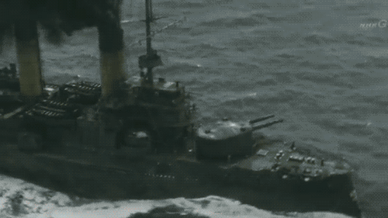
#1 - Militarism
Belief that military power is essential for national strength
Conscription – forced into military/ larger armies
British – German Naval Arms Race
“friendly competition”
Germany expands it navy to become stronger empire

Slide 12
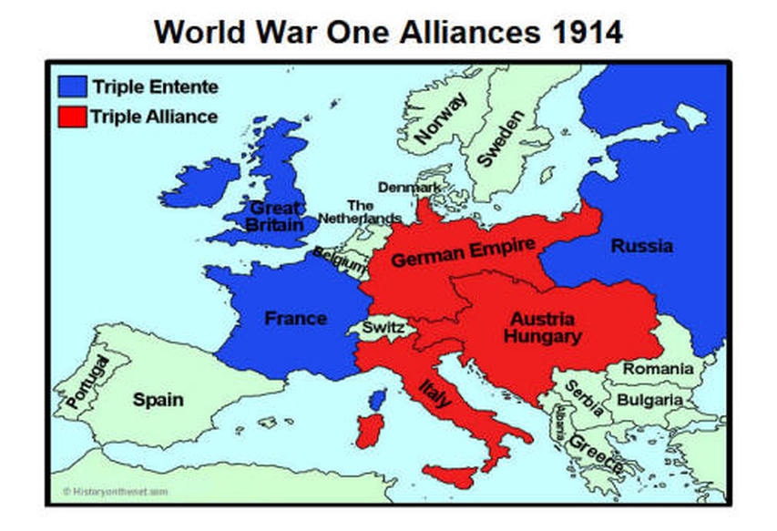
#2 - Alliances
Triple Entente
Great Britain
France
Russia
Triple Alliance
Germany
Austria Hungary
Italy
What disadvantage are there with Central Powers?

Slide 13
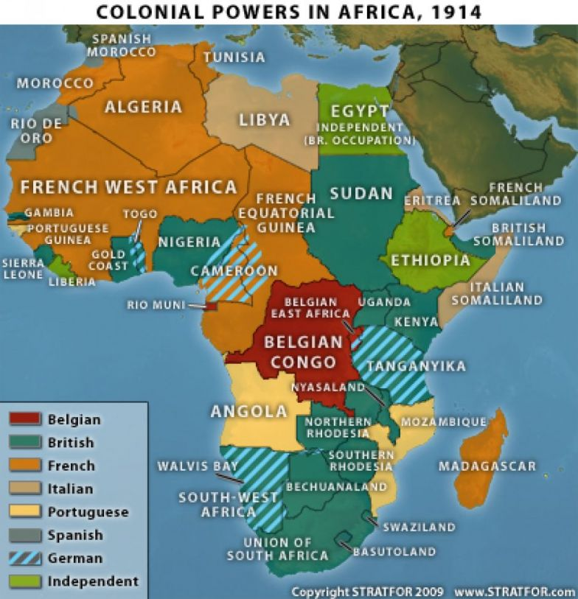
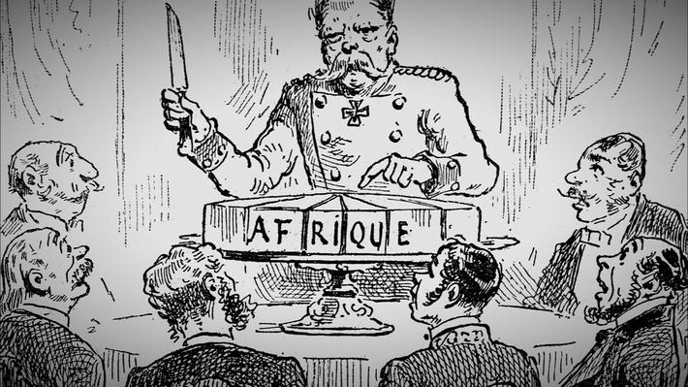
#3 - Imperialism
Fierce competition in Europe for colonies
Social Darwinism – belief that superior nations have right to dominate the weak

Slide 14
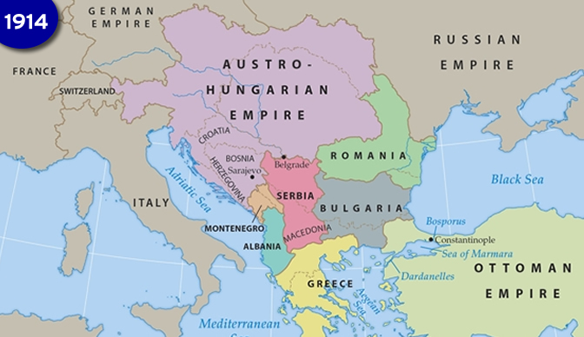
#4 - Nationalism
The unique cultural identity of a people
“Proud of where you came from”
Slavs (people of Eastern Europe) want their own nation
“powder keg of Europe”

Slide 16
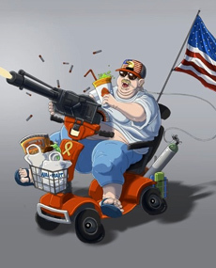
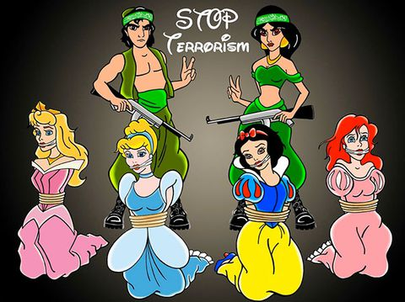
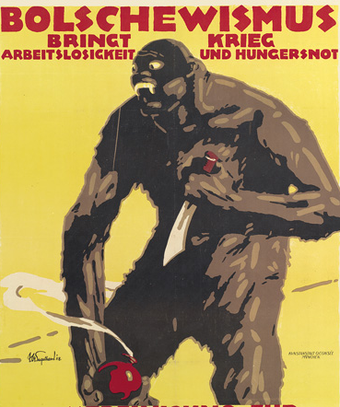
Propaganda
Ideas or forms of media used to influence public opinion
Helps fuel nationalism
Bolshevism brings unemployment, starvation and war!

Slide 17
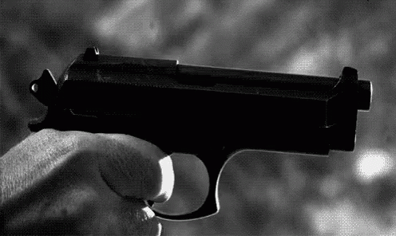
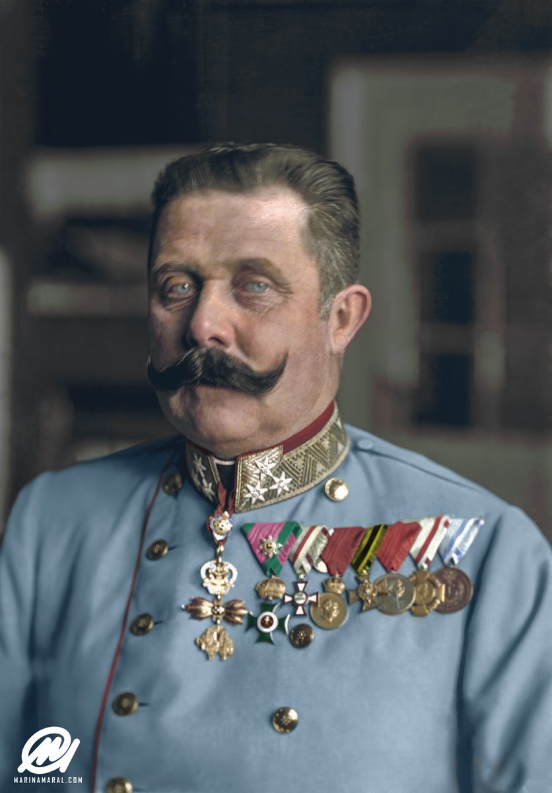
#5 - Assassination

Slide 18
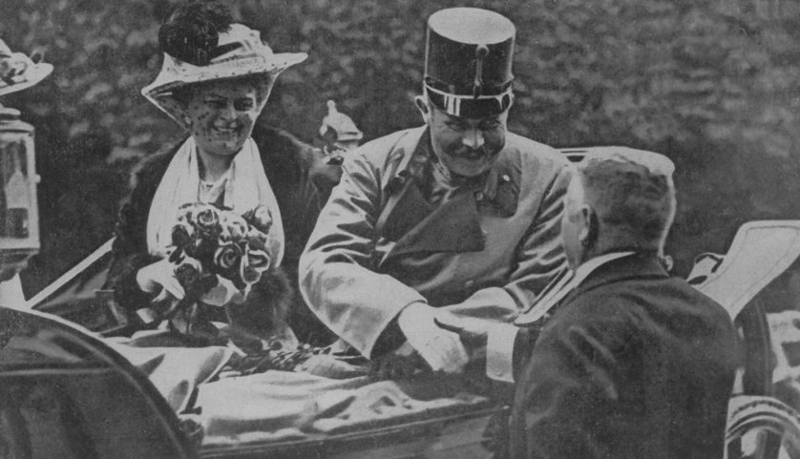
Archduke Franz Ferdinand
Heir to the Austro-Hungarian Throne
Sympathetic to Serbians
Not popular in his empire

Slide 19
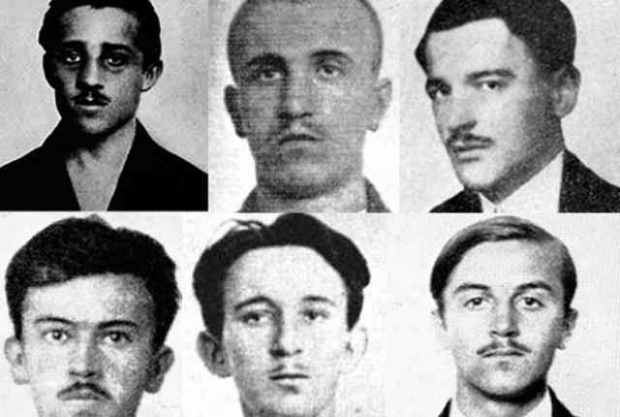
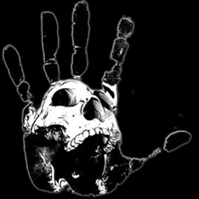
The Black Hand
Bosnian/Serbian Terrorists
Wants Serbian sovereignty
Uses the Archduke’s visit to send a message to the world
Advised by friends not to go

Slide 20
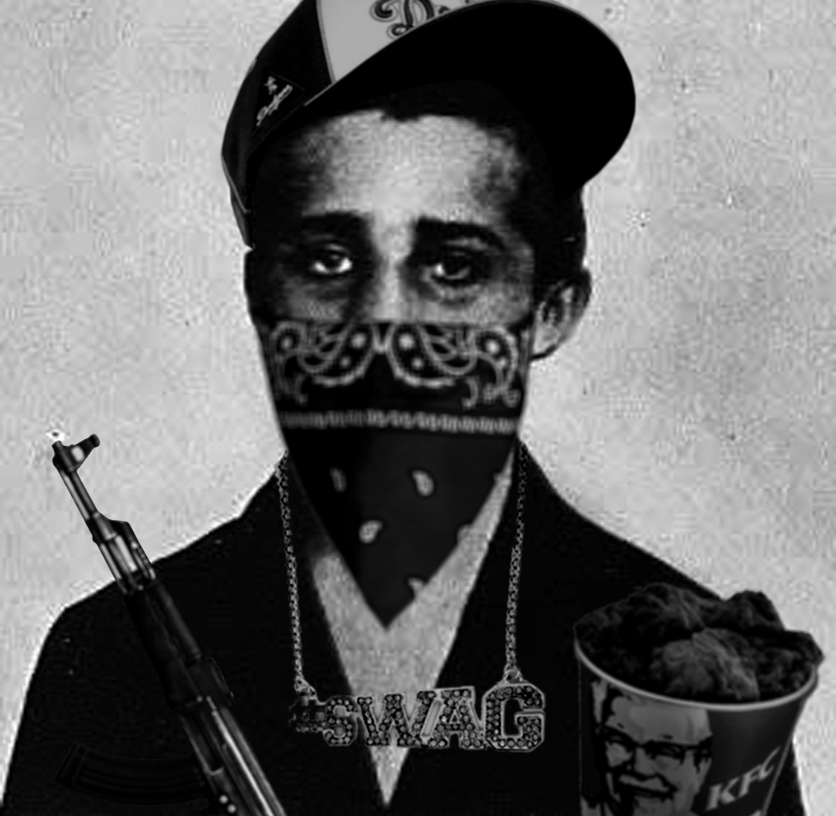
The Murder Suspect
Gavrilo Princip
19 year old Serbian
Proud member of Black Hand
I aimed at the archduke. I do not remember what I thought at that moment.
I am the son of peasants and I know what is happening in the villages. I regret nothing!

Slide 21
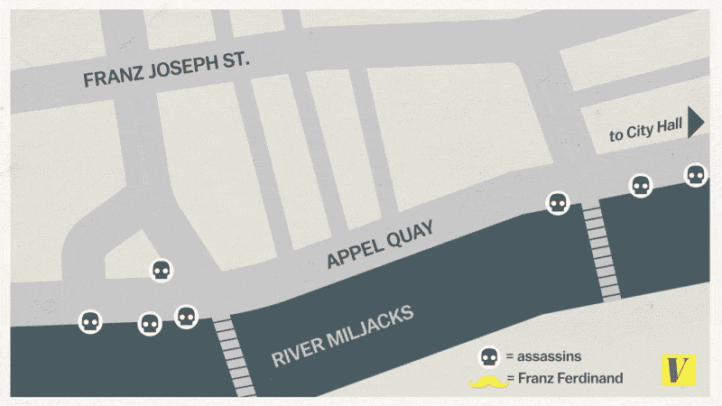

Slide 22
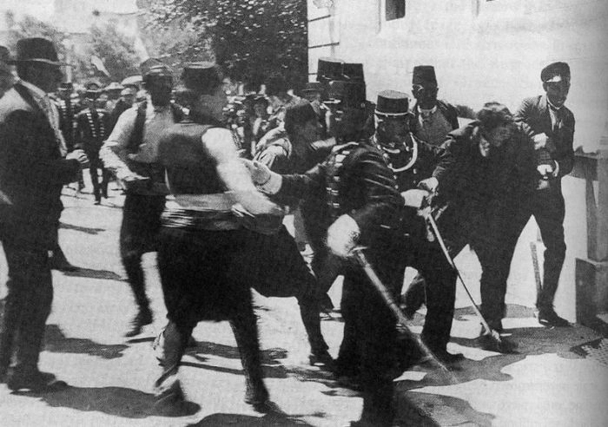
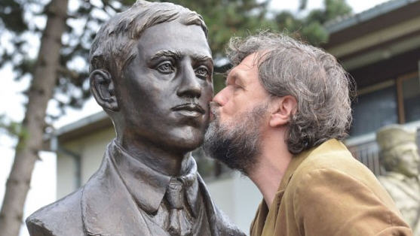
What should his punishment be for the crime?

Slide 23
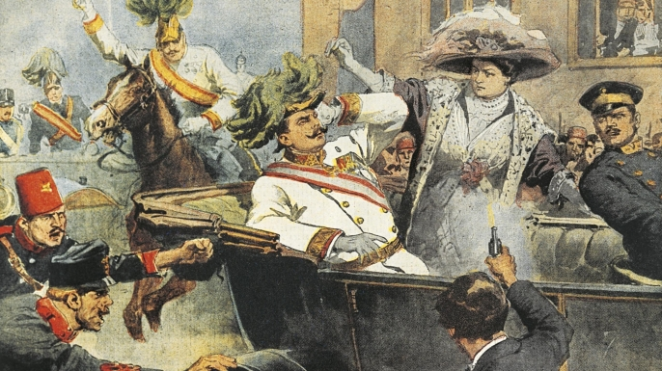
“Sofia, you must live for our children! You must live…” Archduke’s last words.

Slide 24
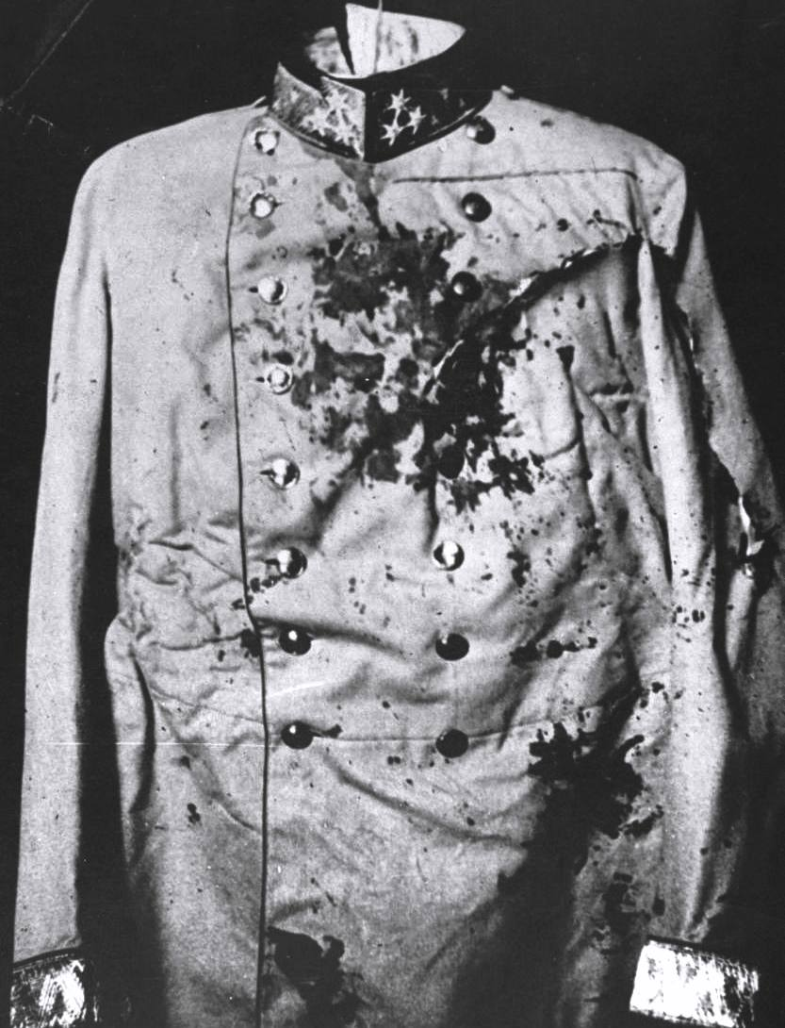
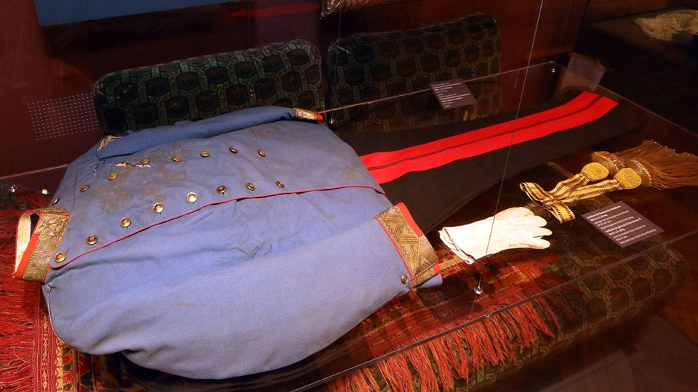

Slide 25
Your Opinion Matters!
Make a quick list of MAIN + A causes of WWI from most significant to least on your paper.
Provide a sentence to justify your answer.

Slide 28
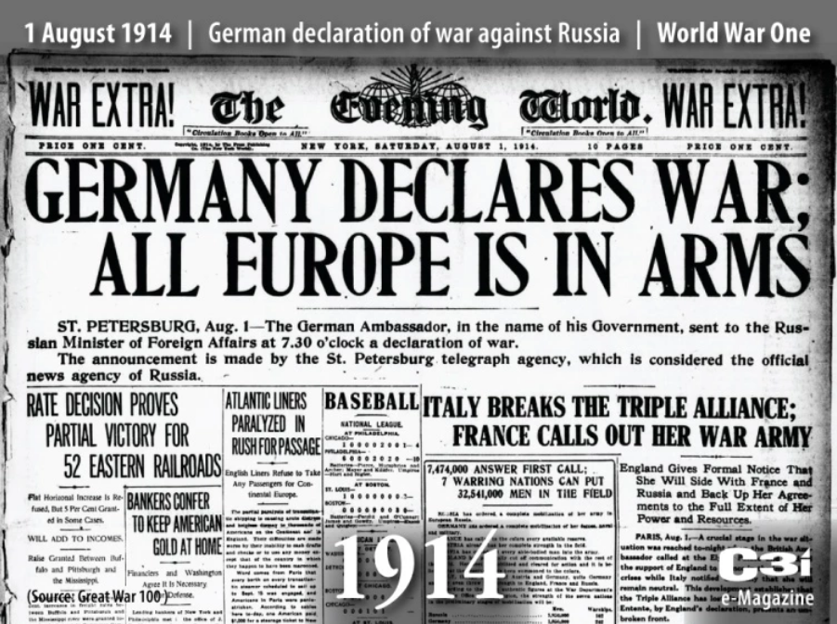

Slide 29
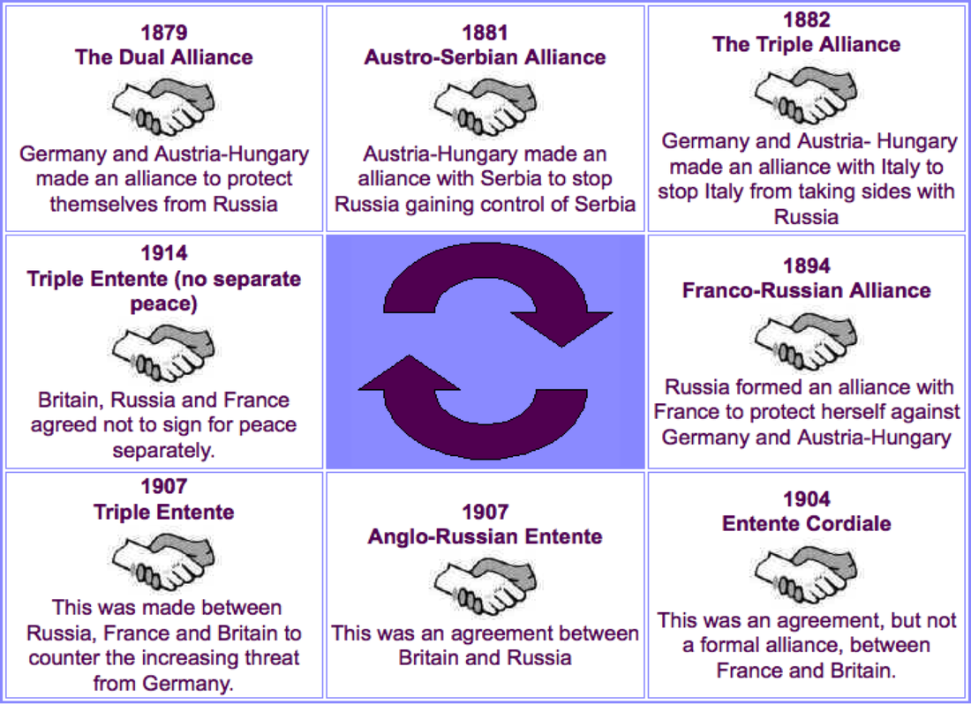

Slide 30
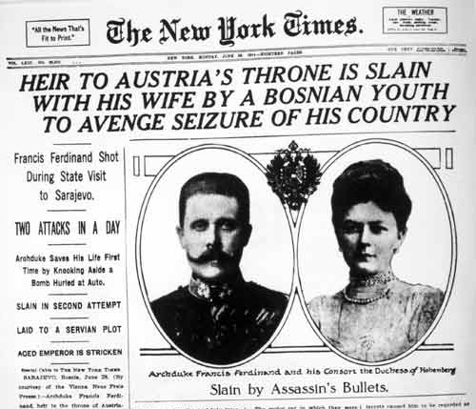

Slide 31
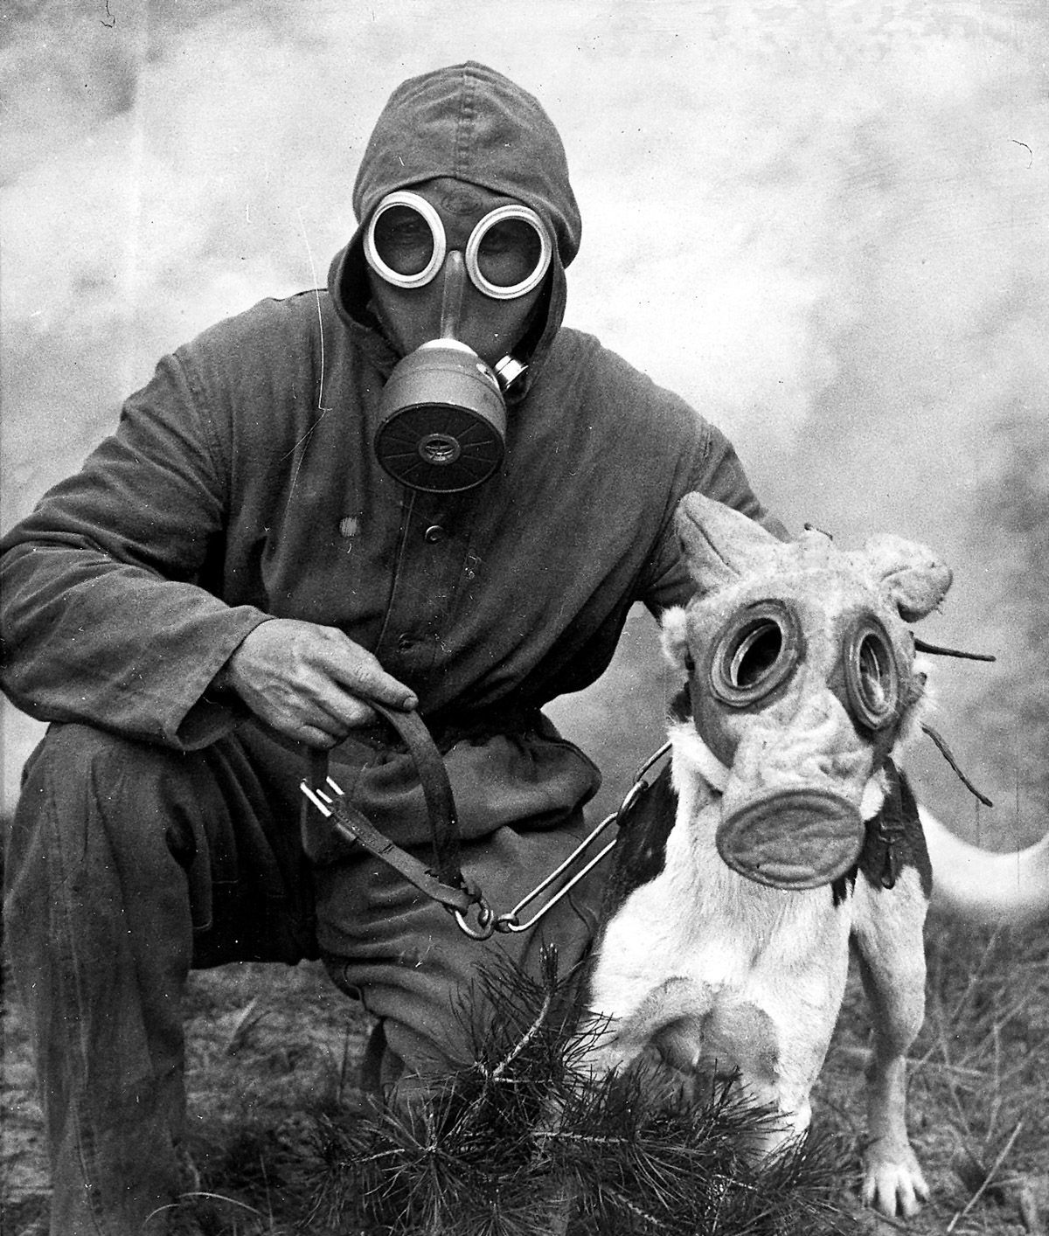
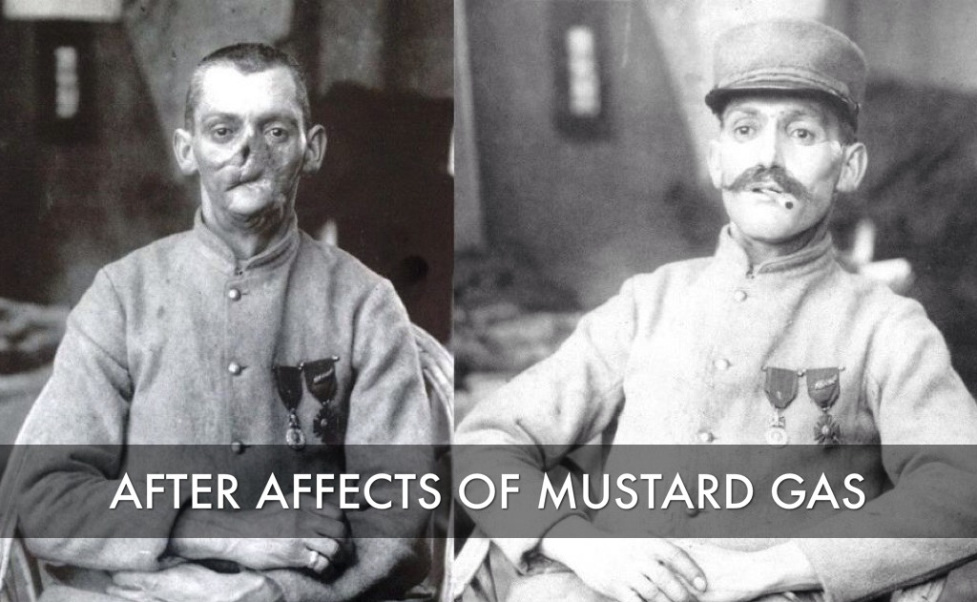
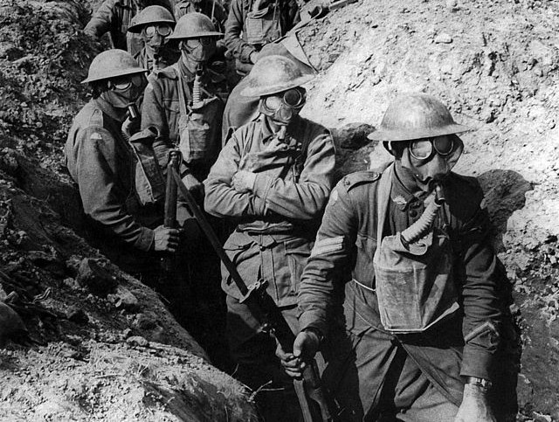
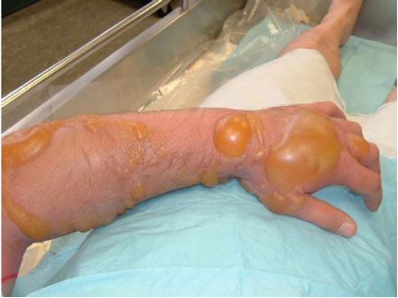
Gas, Gas, Gas!
Get a gas mask from the front container!
Don’t be caught DEAD without one!

Slide 32
Terrorist Attack Brings WAR!

